Slide 1

KoreKit

Slide 2
Attributions, Usage Disclaimer & Contact
All content is either sourced from pixabay.com under the Pixabay License (royalty-free) or is original work created by the author.
This content resource is sold with usage rights granted to the purchaser only. Please do not redistribute, resell, or reupload this content in its original or modified form. Respecting these terms helps support the continued creation of these teaching materials/games!
Have a question or requests for new games or updates to existing ones? Email: korekitgames@gmail.com

Slide 3
Grade 3 – Lesson: Hello/Greetings
This game aligns with intro/greeting chapters on “Hello I am ______.” and supports learning their key expressions and vocabulary.
Phrases and vocabulary used in this game:
Hello/Hi I am __________.
Goodbye __________. Bye ___________.
Insert names where applicable of the characters that are introduced in the textbooks you are using! Do this by simply editing/typing into the text boxes on each slide.
(Insert name)
(Insert name)
(Insert name)

Slide 4
Instructions for Game
Game title: Pirate Island Blast
Concept: Four characters enter one of the four cannons. Have students choose one of the key vocab words pasted on each cannon to write down (and or say aloud). Click through animations and sound effects to find out which character gets blasted! Students who wrote a word for a non-blasted cannon/character get a point(s) while those who wrote a word for a blasted cannon/character get 0 points. Multiple cannons will begin blasting each round as the game progresses!

Slide 5

Editing Game
This game is editable! To do this – simply edit the text boxes to include new key words and vocabulary to replace the existing words. You may need to reposition or slightly adjust the textboxes depending on the length of the new words or phrases you enter.
If you wish to mute the background music, go to the title slide/slide 6 and then click the “Animations” tab -> Animation Pane -> select the audio symbol (just above the slide) -> click the playback tab -> mute/slide the volume option down

Slide 6


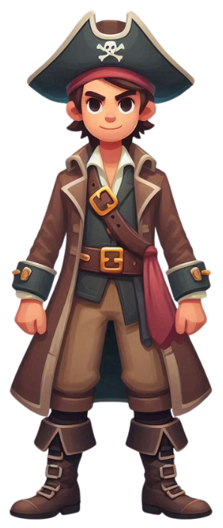



Pirate Island Blast

Slide 7
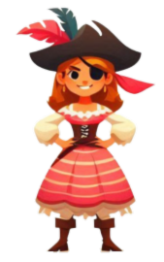



Hello
I
am
(Insert name).

Slide 8
Hi
I
am
(Insert name).

Slide 9
Hello
I
am
(Insert name).

Slide 10
Hello
I
am
(Insert name).

Slide 11
Hello
I
am
(Insert name).

Slide 12
Bye
(Insert name).
Goodbye
(Insert name).

Slide 13
Hi
I
am
(Insert name).

Slide 14
Hello
I
am
(Insert name).

Slide 15
Bye
(Insert name).
Goodbye
(Insert name).

Slide 16
Bye
(Insert name).
Goodbye
(Insert name).

Slide 17
Bye
(Insert name).
Goodbye
(Insert name).

Slide 18
Bye
(Insert name).
Goodbye
(Insert name).

Slide 19
Bye
(Insert name).
Goodbye
(Insert name).

Slide 20
The End!

