Slide 1

KoreKit

Slide 2
Attributions, Usage Disclaimer & Contact
All content is either sourced from pixabay.com under the Pixabay License (royalty-free) or is original work created by the author.
This content resource is sold with usage rights granted to the purchaser only. Please do not redistribute, resell, or reupload this content in its original or modified form. Respecting these terms helps support the continued creation of these teaching materials/games!
Have a question or requests for new games or updates to existing ones? Email: korekitgames@gmail.com

Slide 3
Grade 4 – Lesson: What time is it?
This game aligns with chapters on “What time is it?” and supports learning their key expressions and vocabulary.
Phrases and vocabulary used in this game:
What time is it?
It’s ___________ o’clock
Five, ten, twenty, thirty, forty, fifty
It’s time for breakfast / to wake up / school / lunch / class / dinner / bed
(one-twelve)

Slide 4
Instructions for Game
Game Title: What time is it?
Concept: This game can be played in teams or individually. Four clocks will show with different times along with a key phrase (i.e “It’s time for breakfast.”) Students should guess which time is the correct one by writing down the one most likely associated with the phrase/event mentioned. For example, “It’s seven-thirty” is most likely to be associated with breakfast time vs. 2/3/4 o’clock regardless if it’s A.M or P.M. Click through the animation to reveal which time is the correct one. Students who write the correct time should earn a point. In the latter half of the game, “golden time” bonus point opportunities will appear for students who answered correctly to guess a specific time within a 5-minute window of the correct time for a chance to win additional points. For example, if the correct time was 9:00, 9:00-9:05 will be highlighted afterwards for students to simply guess a time to write down within this period i.e “It’s 9:02.” – If they write down the exact correct time by chance, they earn 2 extra points! Student(s) or the team with the most points at the end of the game wins!

Slide 5

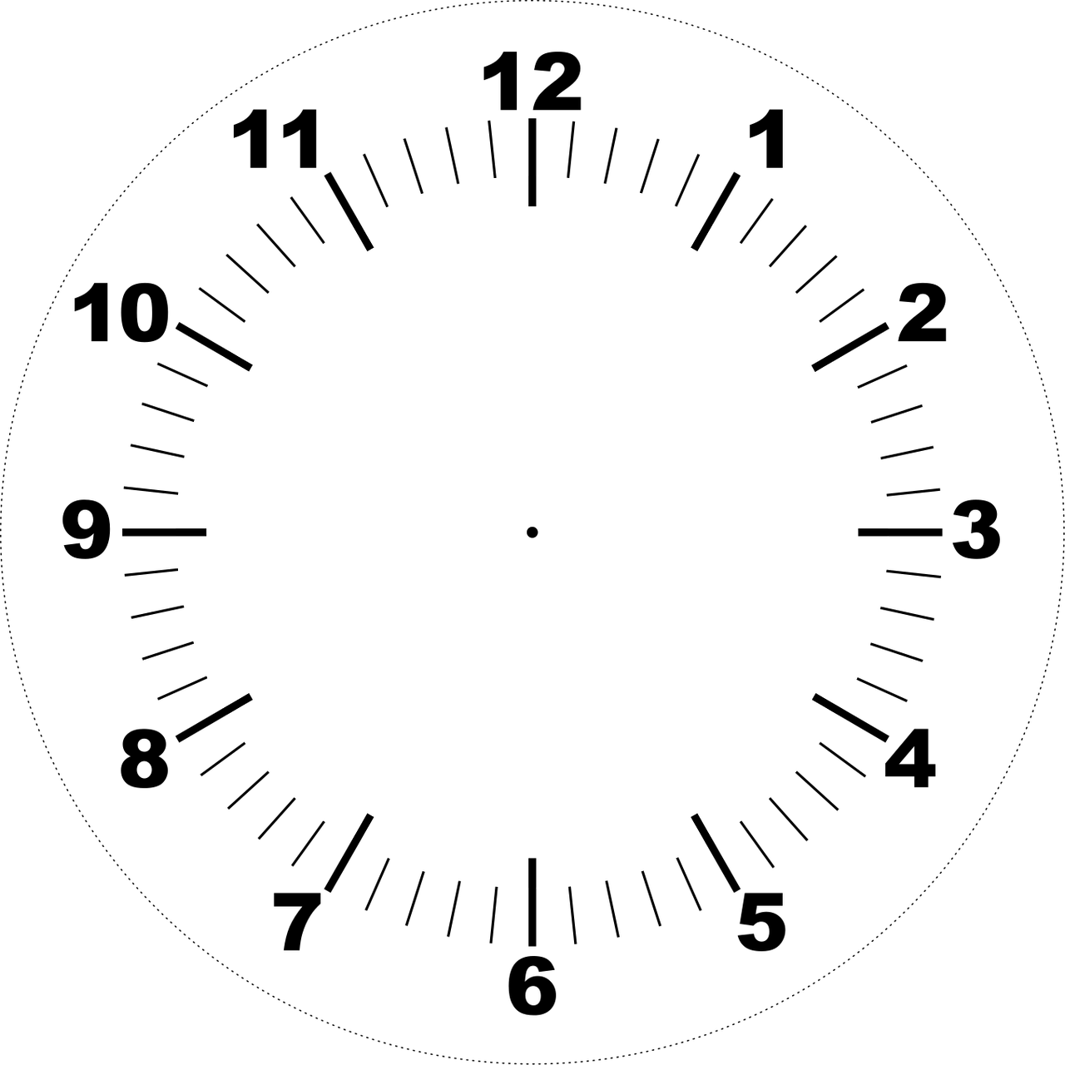
What time is it?

Slide 6
A
What time is it?
B
seven thirty
It’s _____________.
It’s time for breakfast.
C
D

Slide 7
A
What time is it?
B
eight twenty
It’s _____________.
It’s time for school.
C
D

Slide 8
A
What time is it?
B
twelve o’clock
It’s _______________.
It’s time for lunch.
C
D

Slide 9
A
What time is it?
B
one thirty
It’s ____________.
It’s time for class.
C
D

Slide 10
A
What time is it?
B
six o’clock
It’s ____________.
It’s time for dinner.
C
D

Slide 11
A
What time is it?
B
nine o’clock
It’s ____________.
It’s time for bed.
C
D
It’s 9:02
+2 bonus points!

Slide 12
A
What time is it?
B
It’s 6:54
+2 bonus points!
six fifty
It’s ___________.
It’s time to wake/get up.
C
D

Slide 13
A
What time is it?
B
eight ten
It’s ___________.
It’s time for school.
C
D
It’s 8:13
+2 bonus points!

Slide 14
A
What time is it?
B
twelve thirty
It’s ______________.
It’s time for lunch.
C
D
It’s 12:32
+2 bonus points!

Slide 15
A
What time is it?
B
five fifty
It’s ___________.
It’s time for dinner.
C
D
It’s 5:51
+2 bonus points!

Slide 16
The
End!

