Slide 1

KoreKit

Slide 2
Attributions, Usage Disclaimer & Contact
All content is either sourced from pixabay.com under the Pixabay License (royalty-free) or is original work created by the author.
This content resource is sold with usage rights granted to the purchaser only. Please do not redistribute, resell, or reupload this content in its original or modified form. Respecting these terms helps support the continued creation of these teaching materials/games!
Have a question or requests for new games or updates to existing ones? Email: korekitgames@gmail.com

Slide 3
Grade 4 – Lesson: What do you do?
This game aligns with chapters on jobs/occupations and “What do you do?” and supports learning their key expressions and vocabulary.
Phrases and vocabulary used in this game:
What do you do? / What does he/she do?
I’m/He/She’s a doctor/cook/model/nurse/painter/pilot/writer/ teacher/farmer/firefighter/singer/scientist

Slide 4
Instructions for Game
Game Title: Underwater Treasure
Concept: Four chests will float down with each under a key phrase. Have students choose a chest by writing down the associated text. Chests will contain either gold coins, silver coins, bronze coins, or nothing. Points associated with each coin are explained on slide 6. A squid will begin appearing in one of the chests in the later half of the game and squirt the screen with ink! Those who chose to write the text associated with the squid will lose points. The student(s) with the most points at the end of the game wins!

Slide 5

Editing Game
This game is editable! To do this – simply edit the text boxes to include new key words and vocabulary to replace the existing words. You may need to reposition or slightly adjust the textboxes depending on the length of the new words or phrases you enter.
If you wish to mute the background music, go to the title slide/slide 6 and then click the “Animations” tab -> Animation Pane -> select the audio symbol (just above the slide) -> click the playback tab -> mute/slide the volume option down

Slide 6





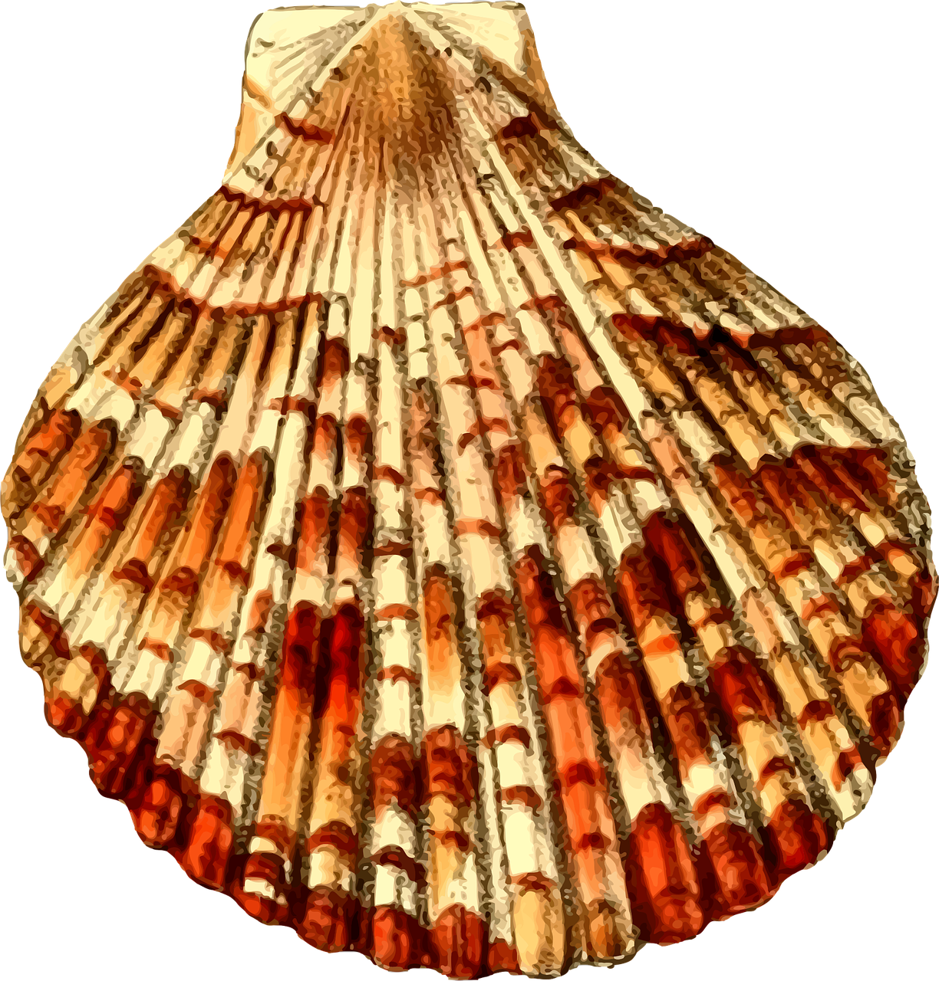
Underwater Treasure

Slide 7
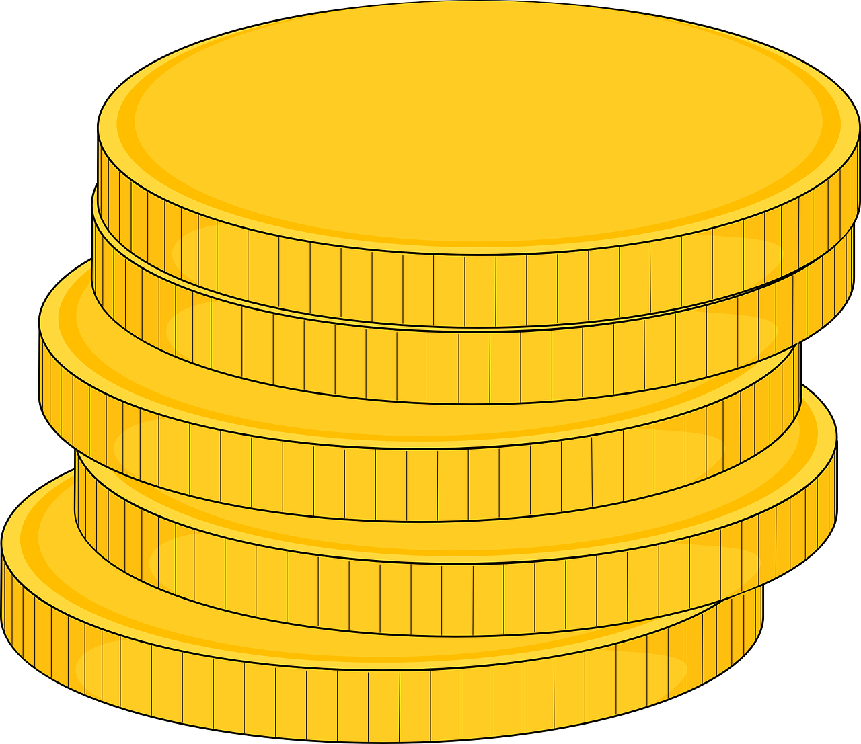
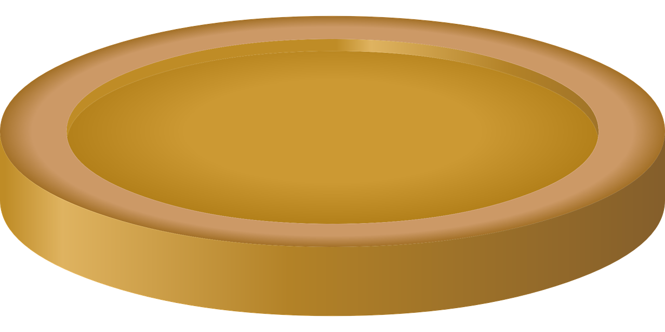


= 1 Point
= 3 Points
= 2 Points
= -2 Points

Slide 8
What do you do?
I’m a doctor.
What does she do?
She’s a doctor.

Slide 9
What does he do?
He’s a cook.
What do you do?
I’m a model.

Slide 10
What does she do?
She’s a nurse.
What does he do?
He’s a painter.

Slide 11
What do you do?
I’m a pilot.
What does she do?
She’s a writer.

Slide 12
What does he do?
He’s a teacher.
What do you do?
I’m a farmer.

Slide 13

What does she do?
She’s a firefighter.
What does he do?
He’s a singer.

Slide 14
What do you do?
I’m a scientist.
What does she do?
She’s a model.

Slide 15
What does he do?
He’s a doctor.
What do you do?
I’m a nurse.

Slide 16
What does she do?
She’s a painter.
What does he do?
He’s a writer.

Slide 17
What do you do?
I’m a teacher.
What does she do?
She’s a pilot.

Slide 18
What does he do?
He’s a cook.
What do you do?
I’m a farmer.

Slide 19
The End!

