Slide 1


Slide 2
Attributions, Usage Disclaimer & Contact
All content is either sourced from pixabay.com under the Pixabay License (royalty-free) or is original work created by the author.
This content resource is sold with usage rights granted to the purchaser only. Please do not redistribute, resell, or reupload this content in its original or modified form. Respecting these terms helps support the continued creation of these teaching materials/games!
Have a question or requests for new games or updates to existing ones? Email: korekitgames@gmail.com

Slide 3
Grade 3 – Lesson: It’s Big / Small
This game aligns with chapters on “It’s big/small.” and supports learning their key expressions and vocabulary.
Phrases and vocabulary used in this game:
Is it a bear/pig/dog/snake/duck/bird?
Yes, it is. / No it isn’t, it’s a _______.
Wow / Oh it’s small/big/long/fast.
This game serves best as a supplemental teaching resource as it includes key phrases and vocabulary from multiple commonly used English textbooks in Korea related to this lesson. This allows the resource to be applicable to most teachers while students can learn related words and phrases beyond their specific chapter, reinforcing the main lesson ideas.

Slide 4
Instructions for Game
Game Title: Is it a bear?
Concept: Have students write and or speak the question at the top of the slide i.e “Is it a bear?”. Students should guess what animal photo is behind the smaller moving animal images and write down their answer i.e “Yes, it is.” or “No, it isn’t.” Some slides will have a follow up answer i.e “Yes, it is. Wow it’s small”. Students should earn a point if they correctly guessed the animal by writing it down. The moving animal images will become larger/faster as the game progresses making it harder to see what animal photo is behind them. The student(s) with the most points at the end of the game wins!

Slide 5

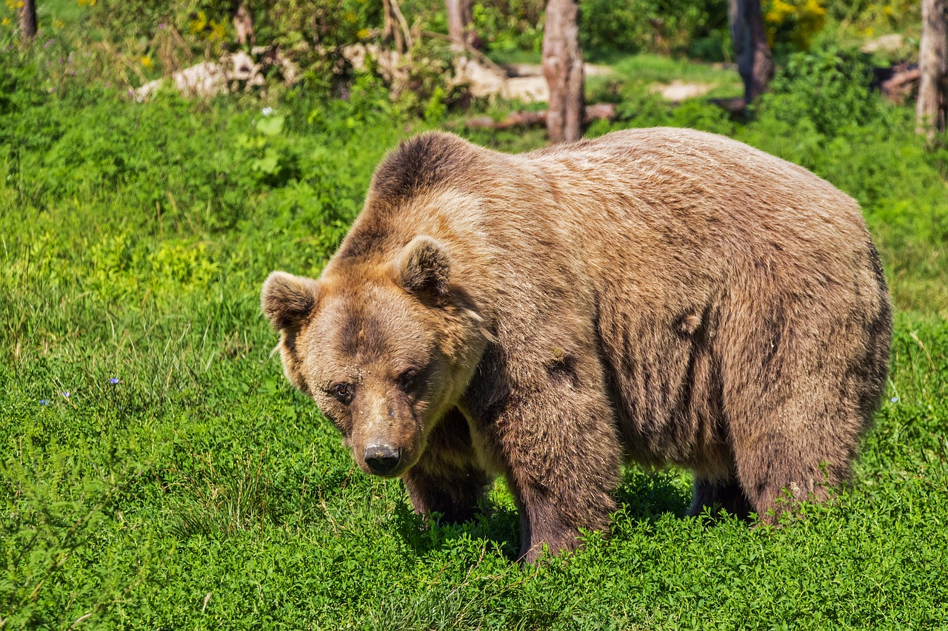
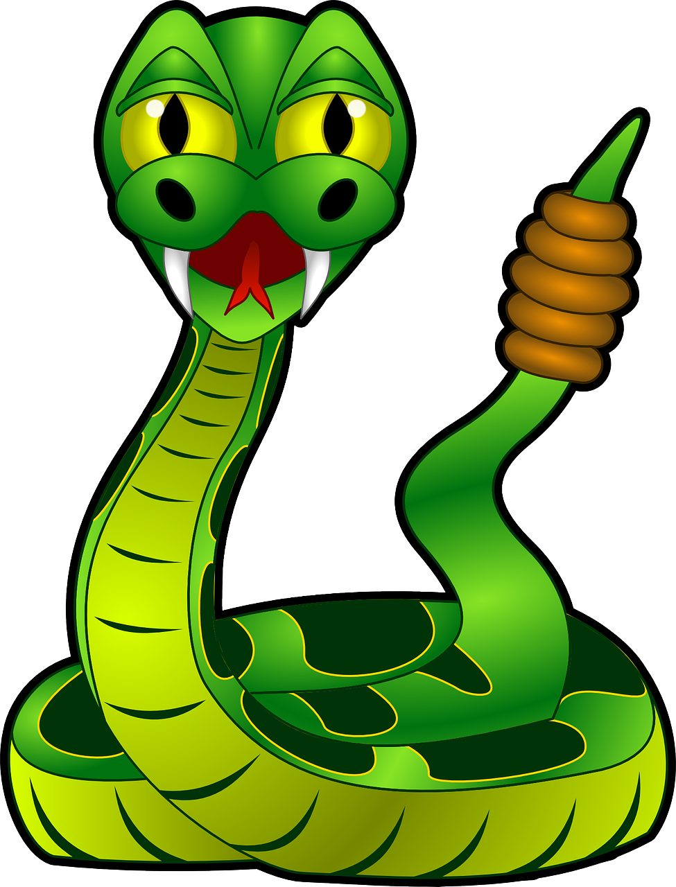
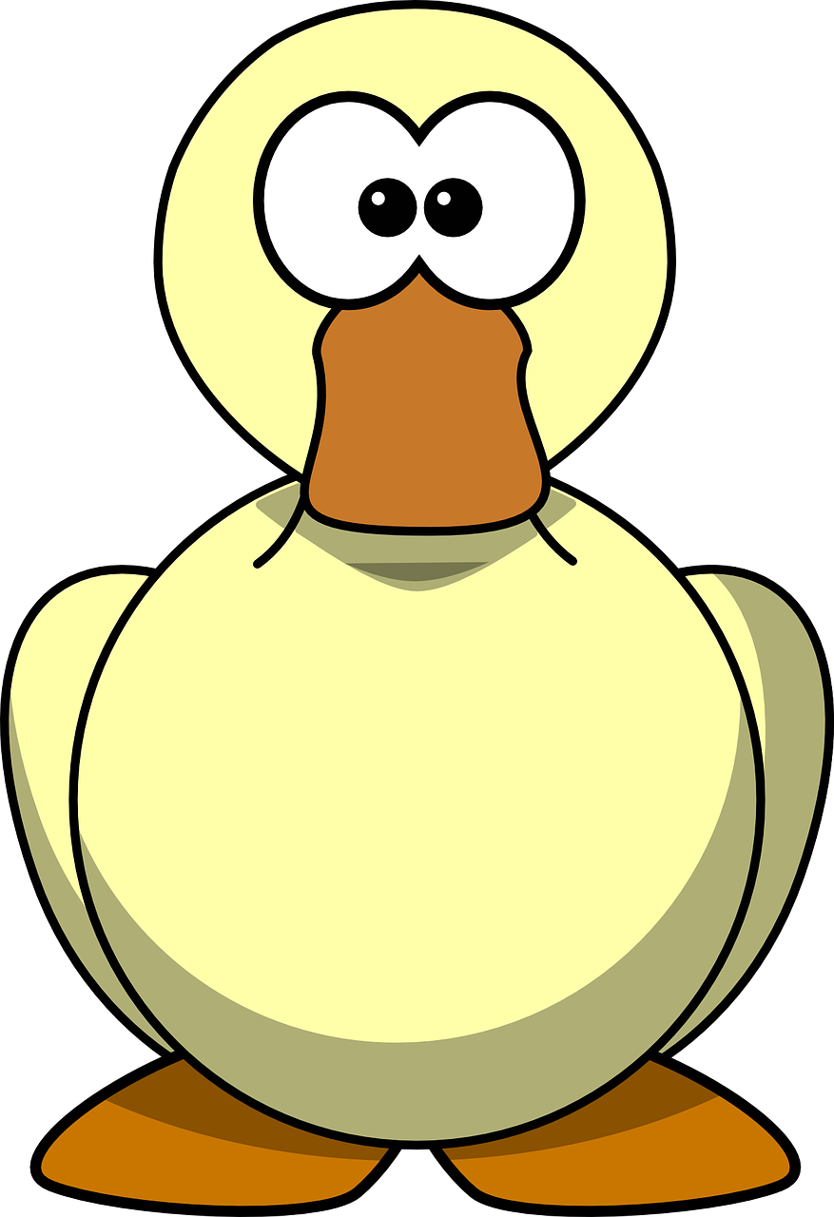

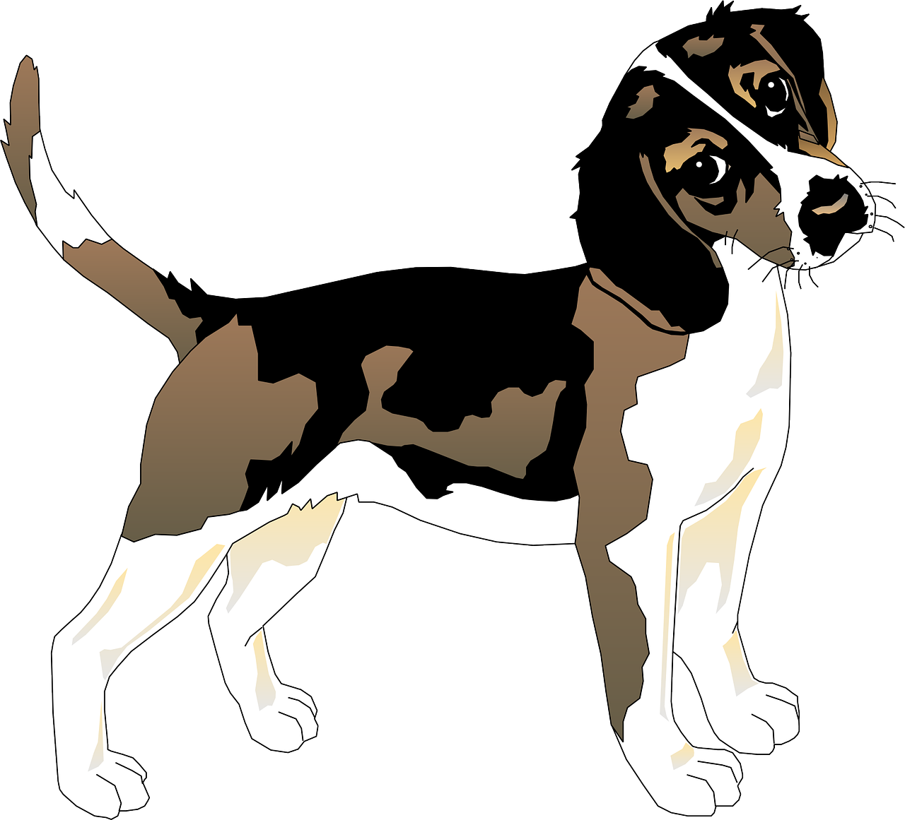

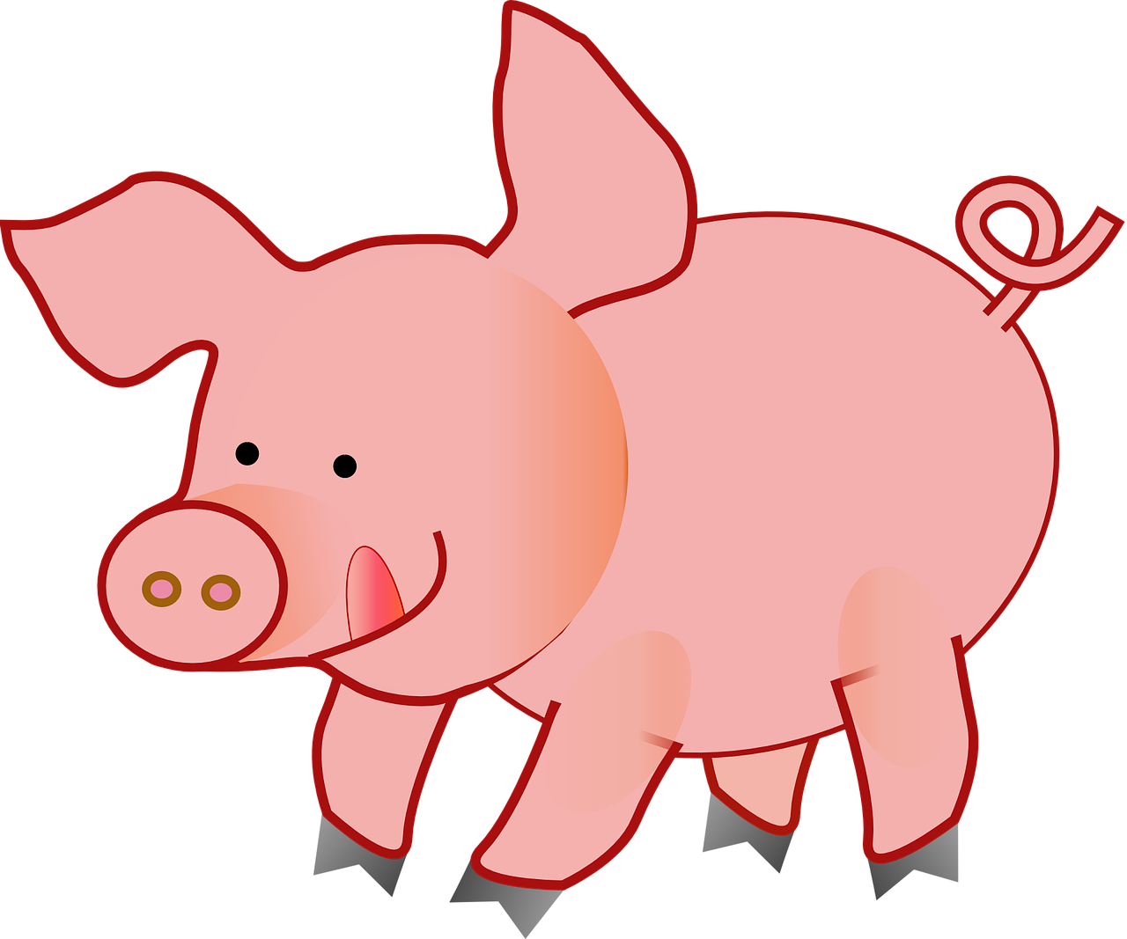
Is it a bear?
Yes, it is.

Slide 6
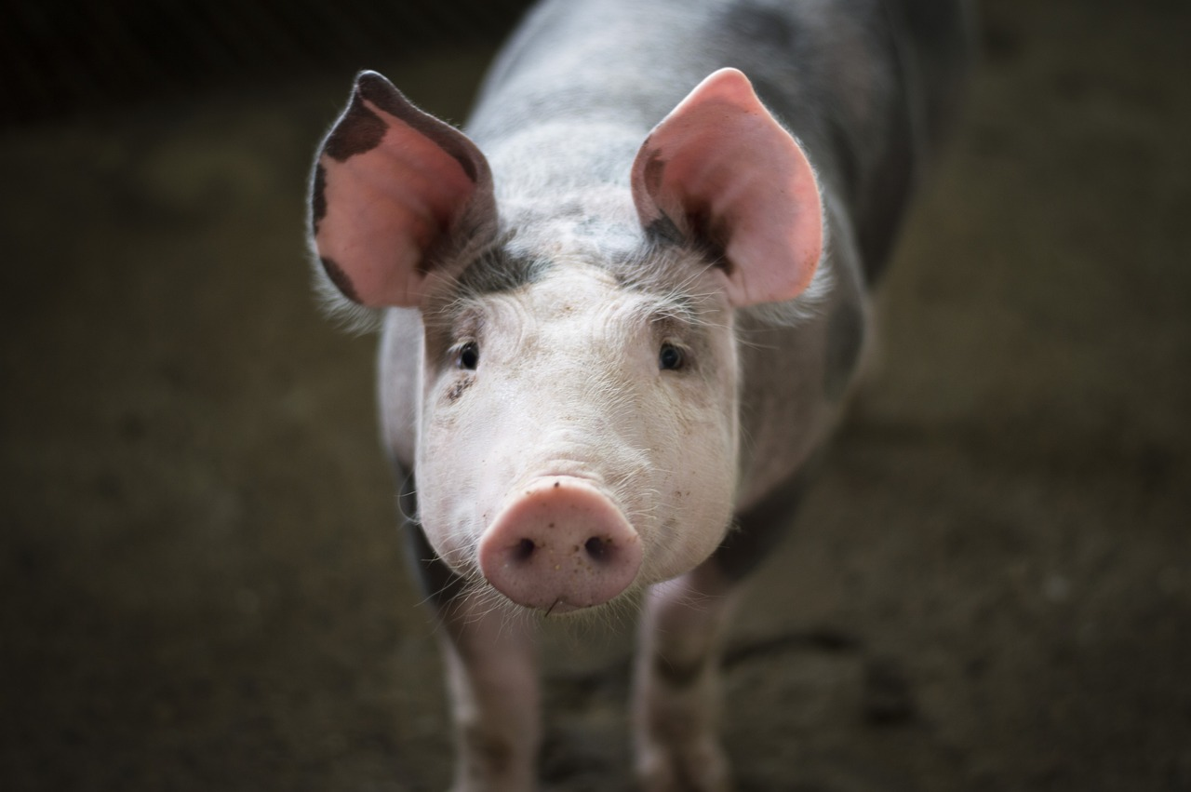
Is it a pig?
Yes, it is.

Slide 7
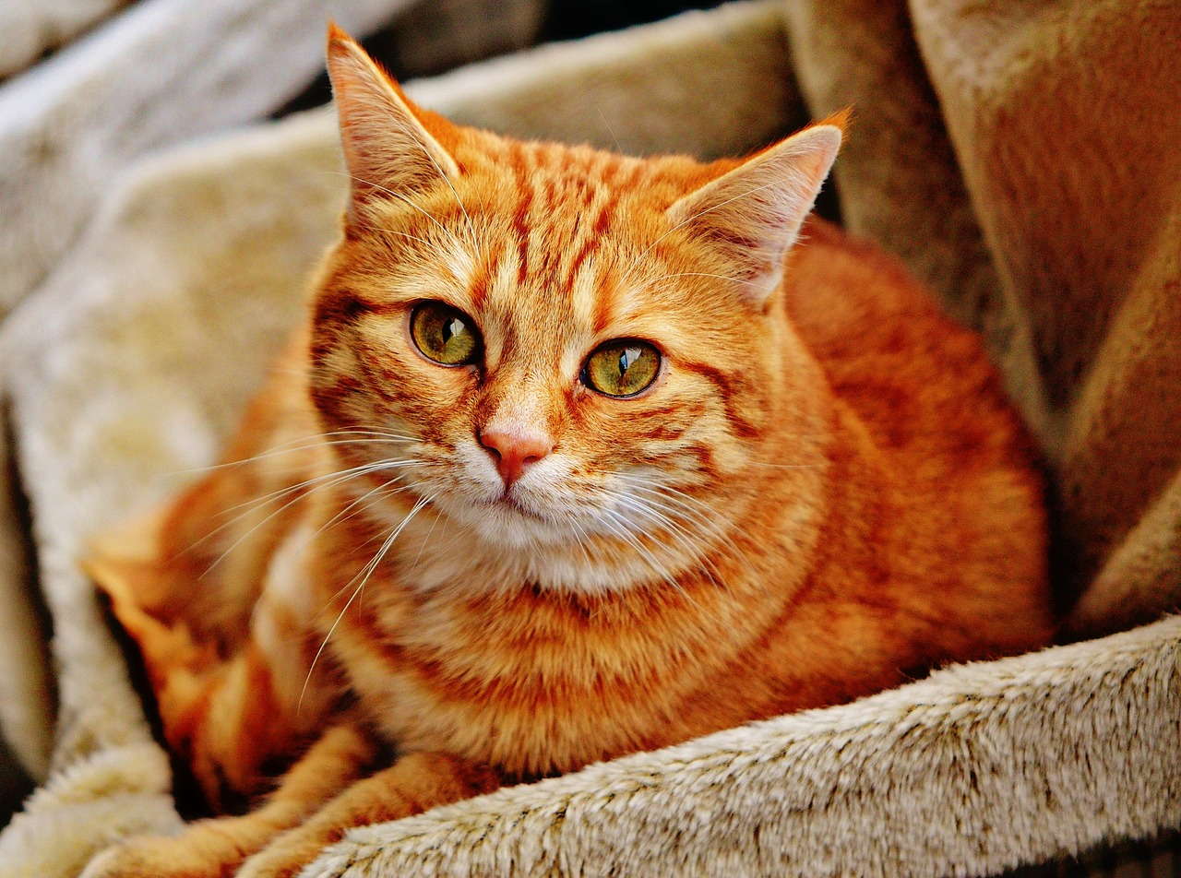
Is it a dog?
No, it isn’t.

Slide 8
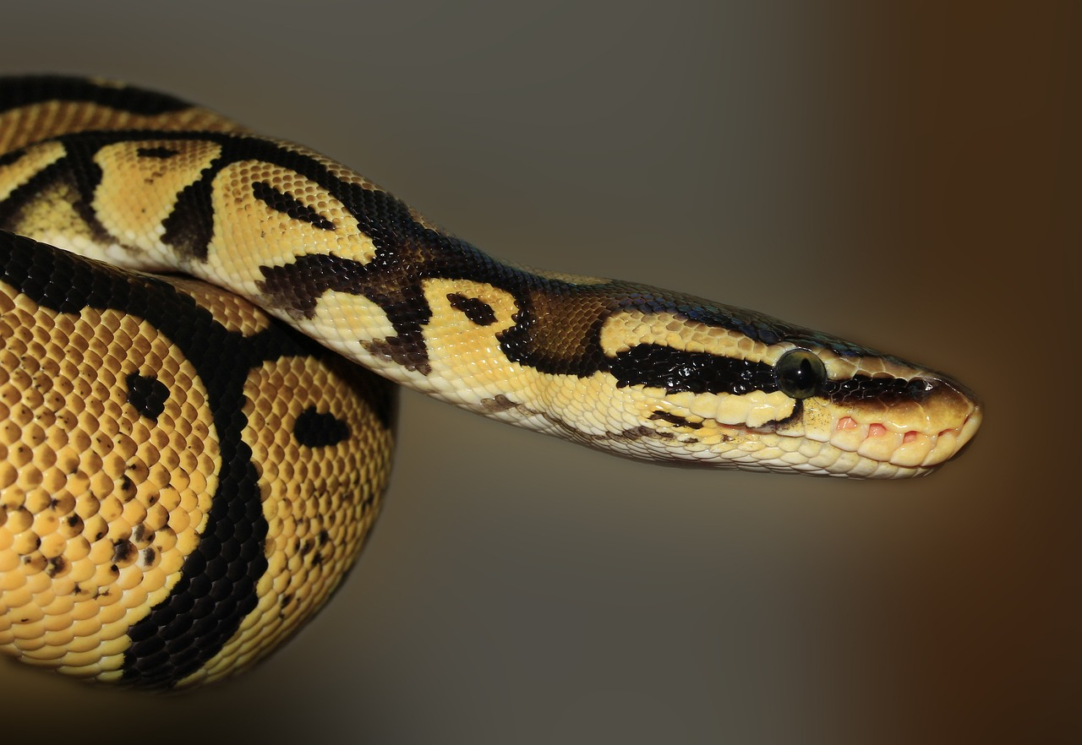
Is it a snake?
Yes, it is.

Slide 9
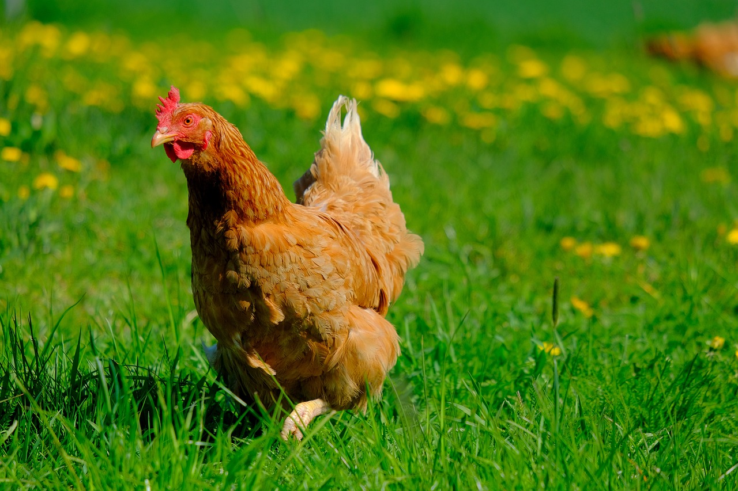
Is it a duck?
No, it isn’t.

Slide 10
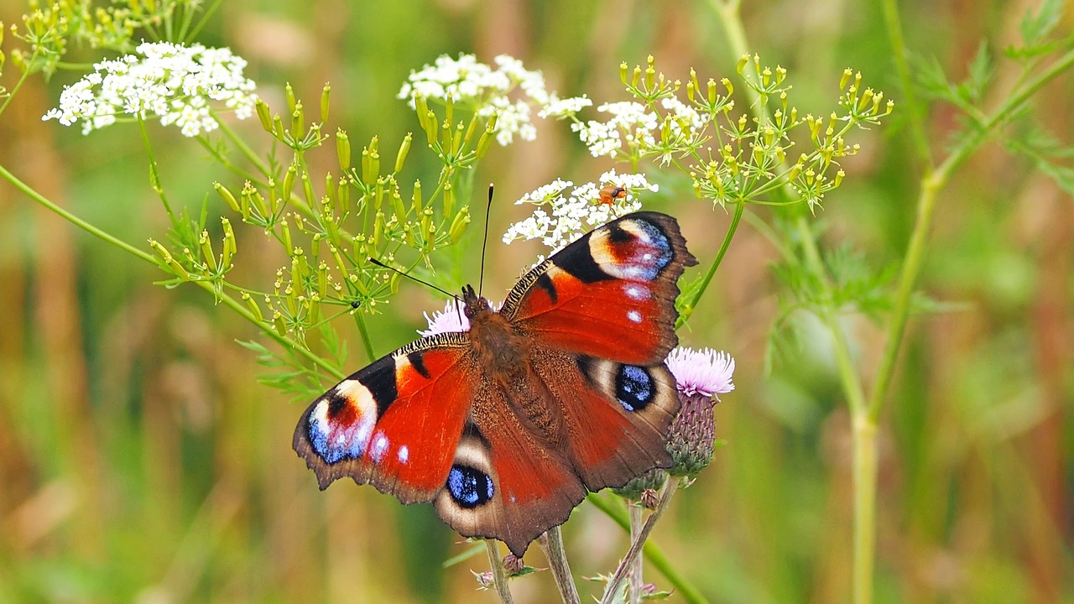
Is it a bird?
No, it isn’t.

Slide 11
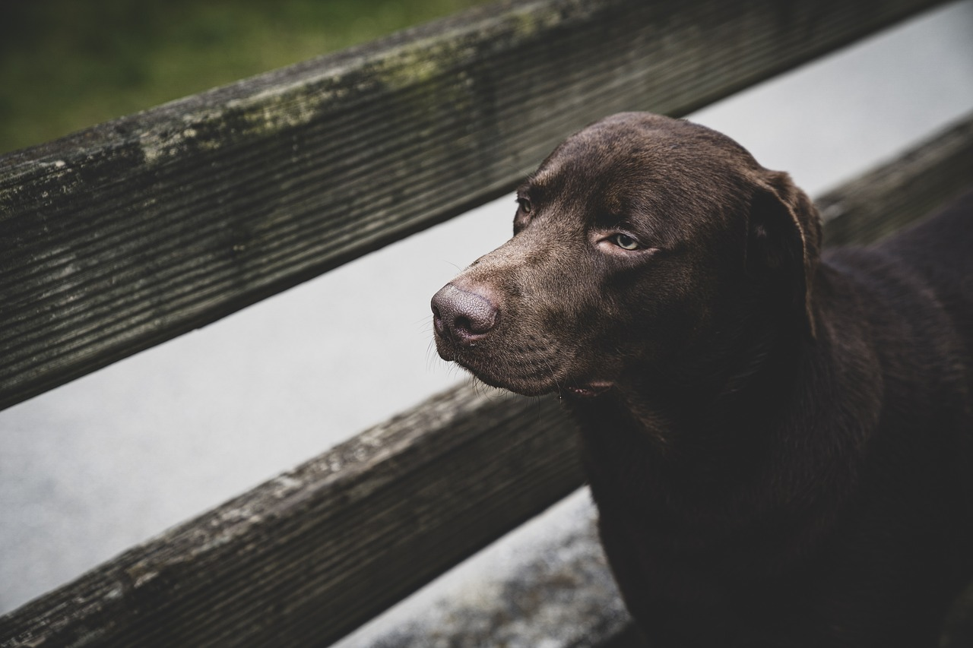
Is it a bear?
No, it isn’t.
It’s a ___.
dog

Slide 12
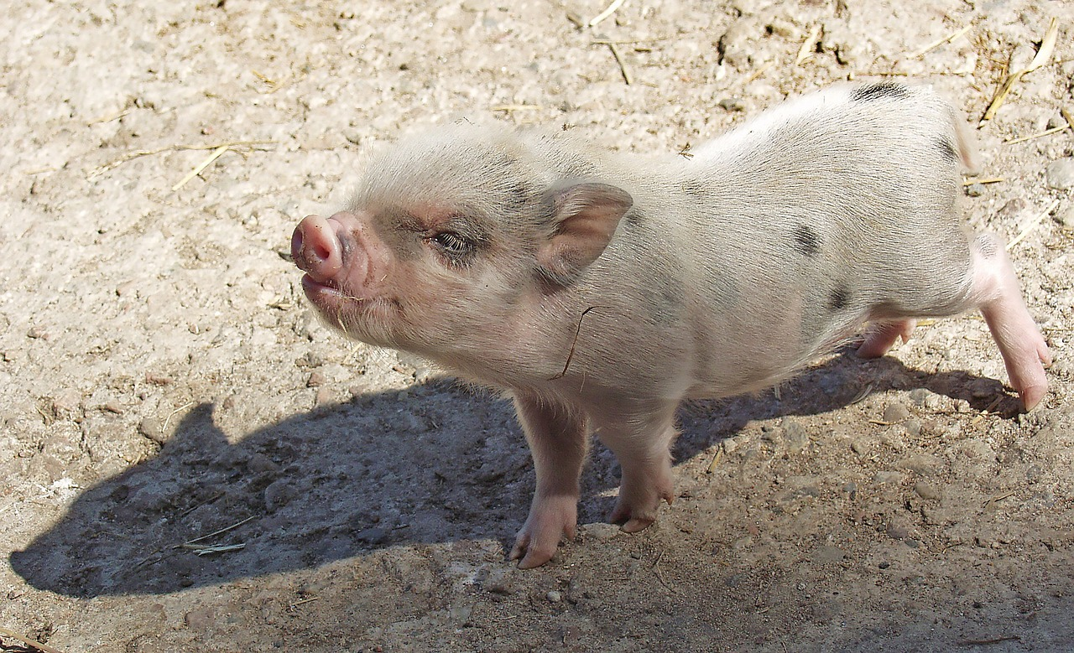
Is it a pig?
Yes, it is.
It’s _____.
small

Slide 13
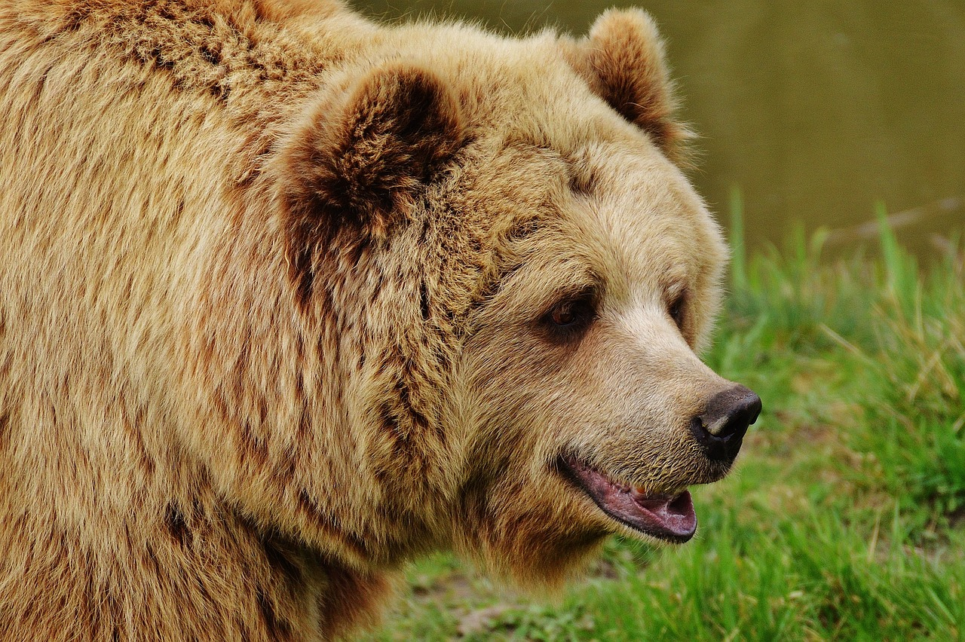
Is it a bear?
Yes, it is.
It’s ___.
big

Slide 14
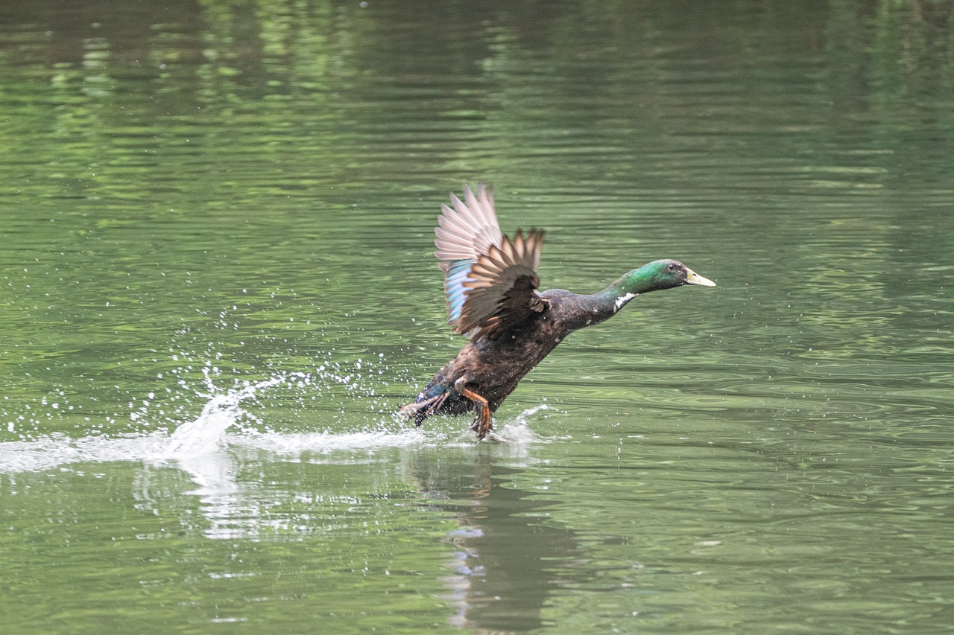

Is it a duck?
Yes, it is.
It’s ___ .
fast

Slide 15
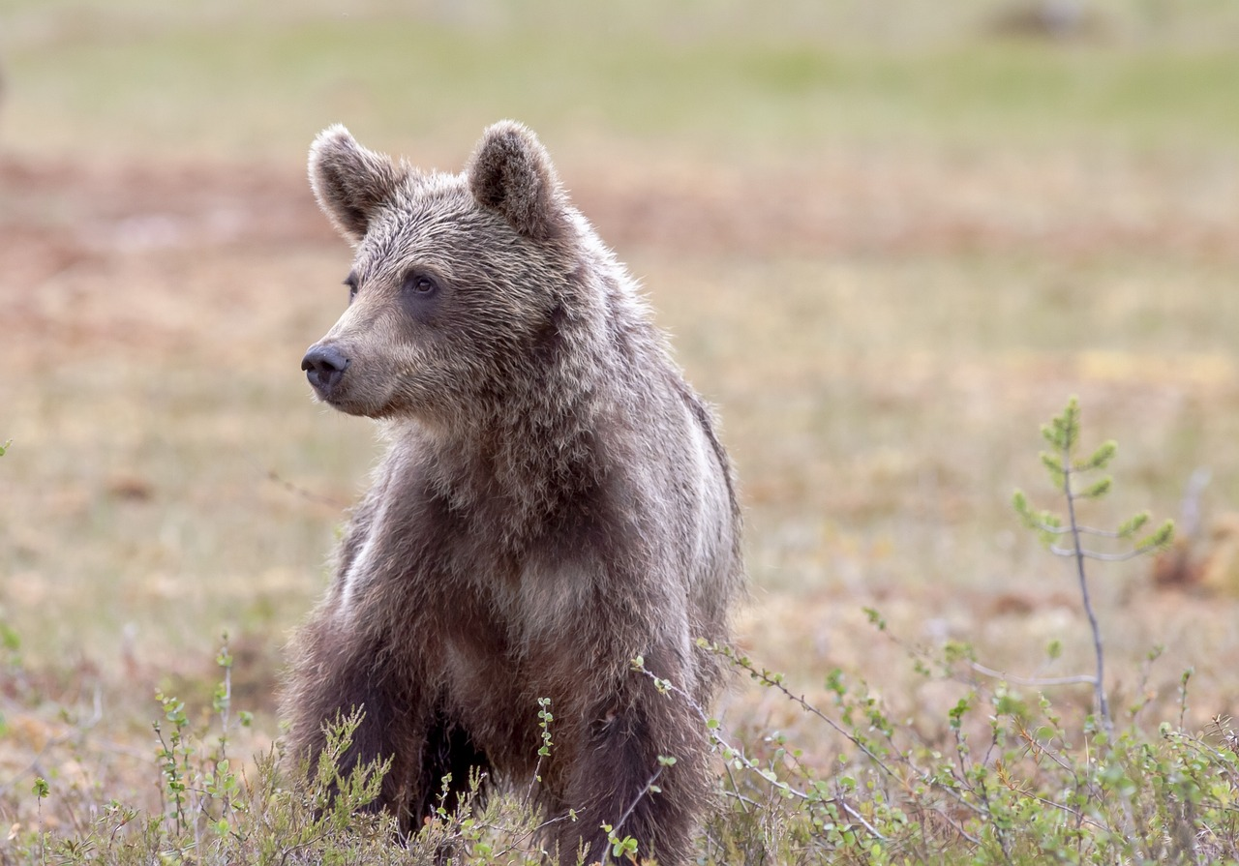
Is it a dog?
No, it isn’t.
It’s a ____.
bear

Slide 16
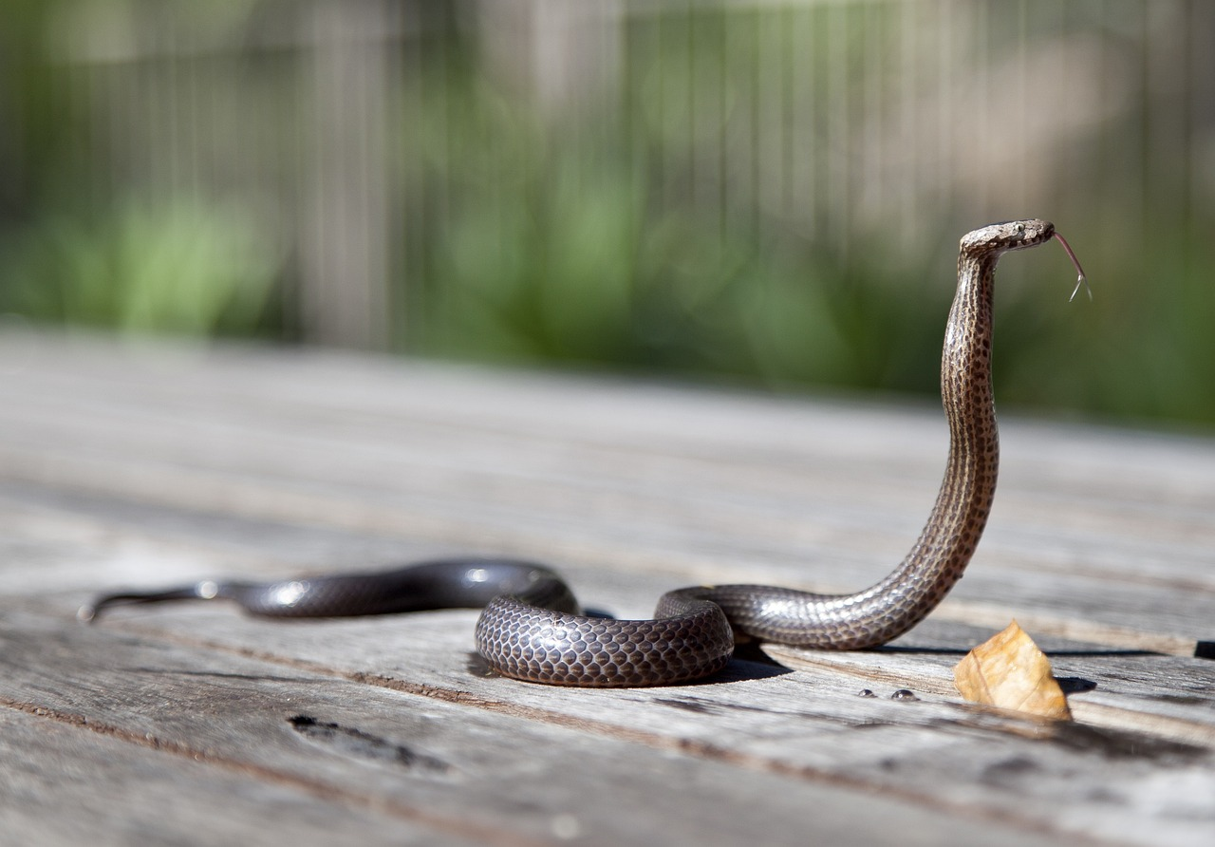

Is it a snake?
Yes, it is.
It’s ____ .
long

Slide 17
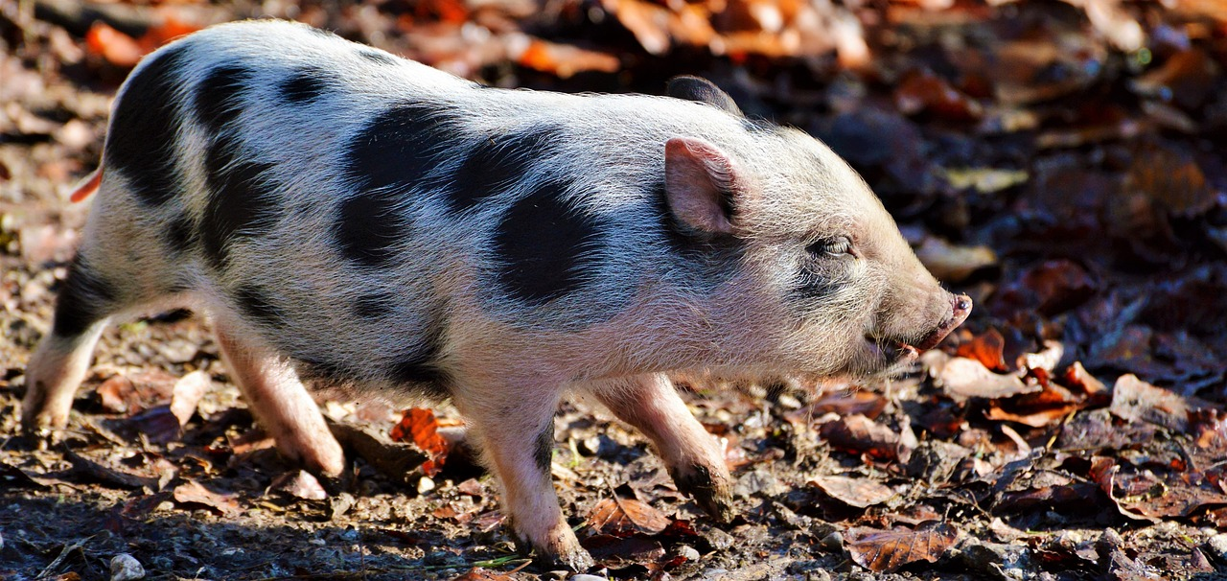
Is it a duck?
No, it isn’t.
It’s a ___.
pig

Slide 18
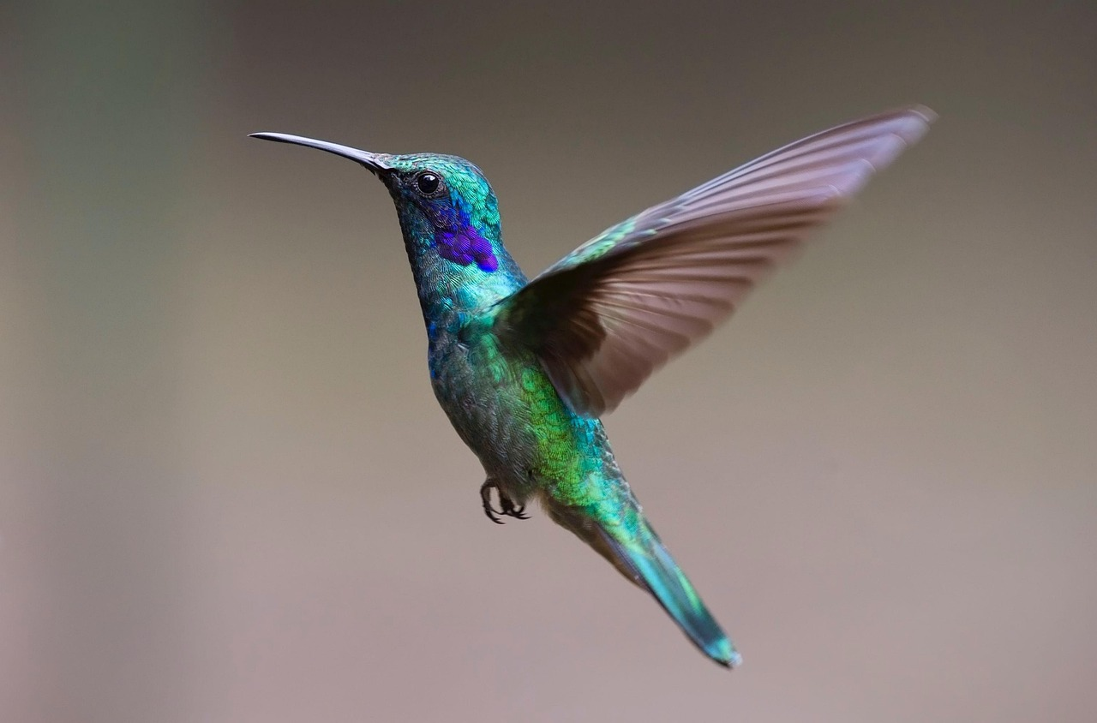
Is it a bird?
Yes, it is.
Oh, it’s ___.
fast

Slide 19
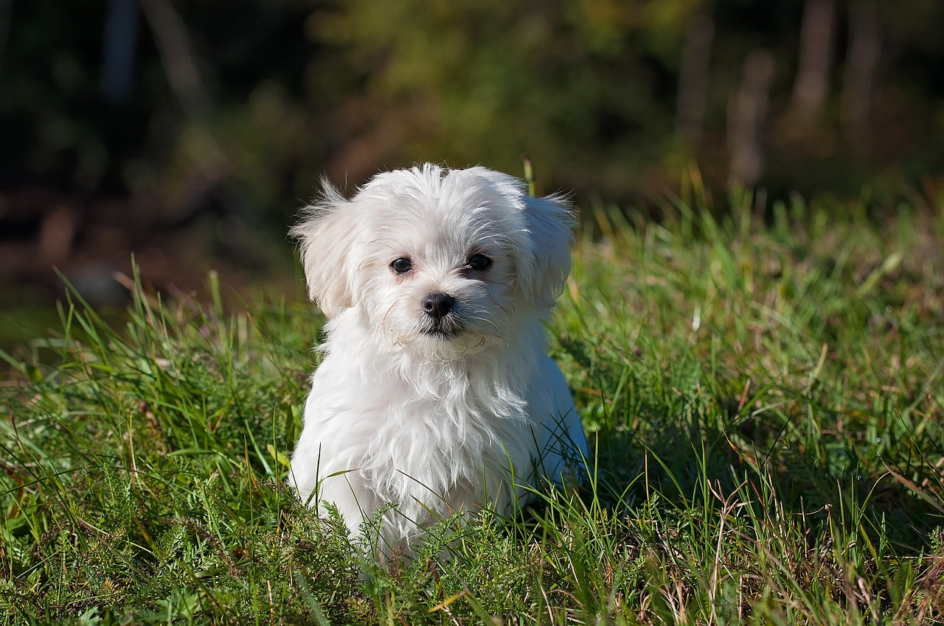
Is it a dog?
Yes, it is.
It’s ______ .
small

Slide 20
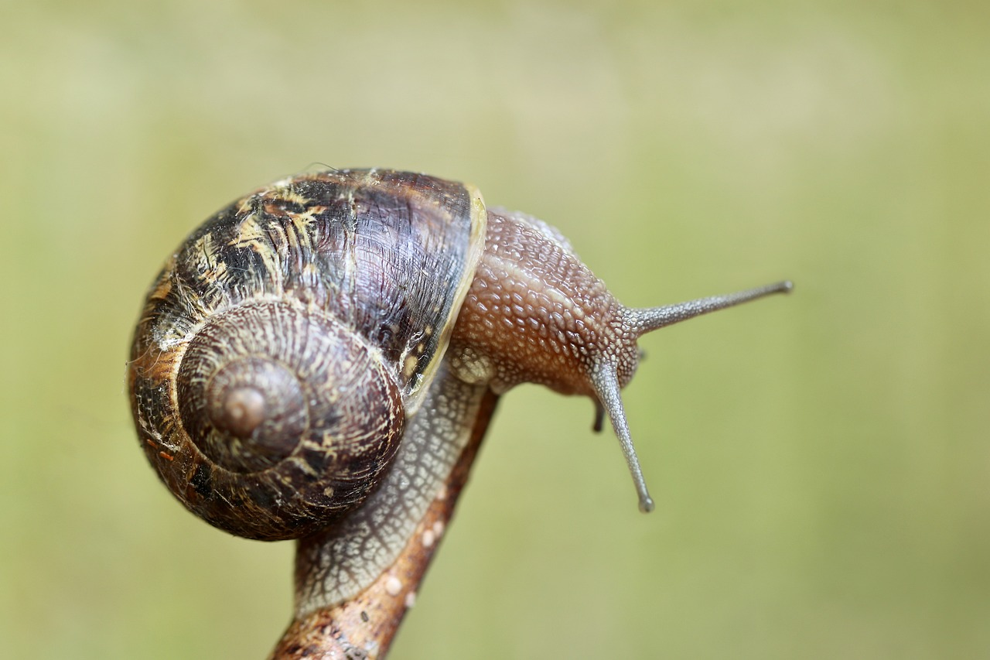
Is it a snake?
No, it isn’t.
Wow, it’s _____.
small

Slide 21
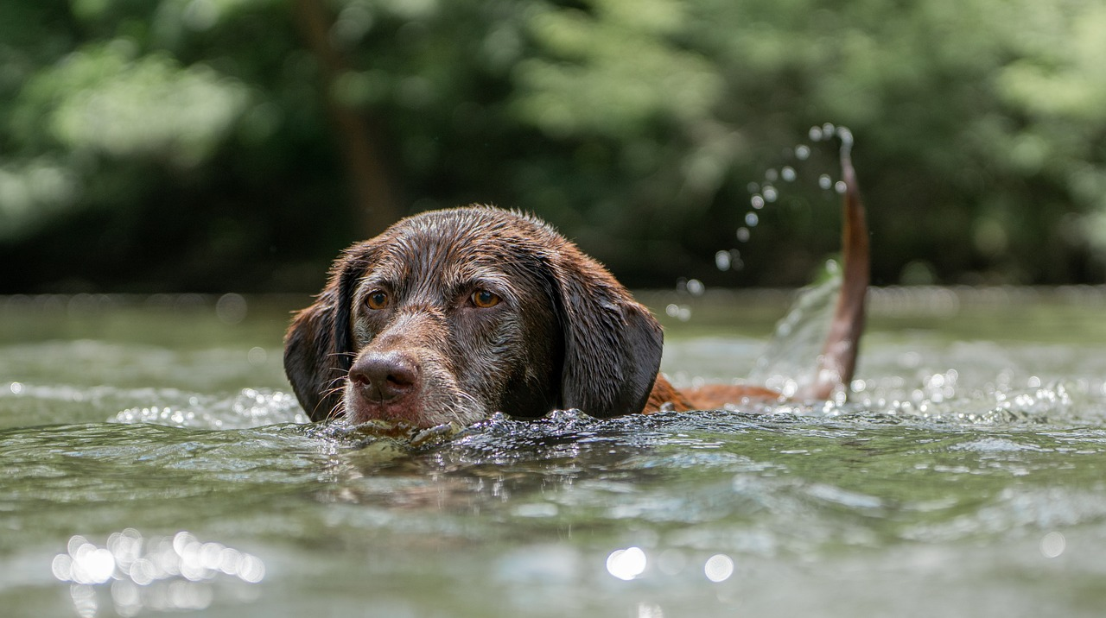
Is it a duck?
No, it isn’t.
It’s a ___.
dog

Slide 22
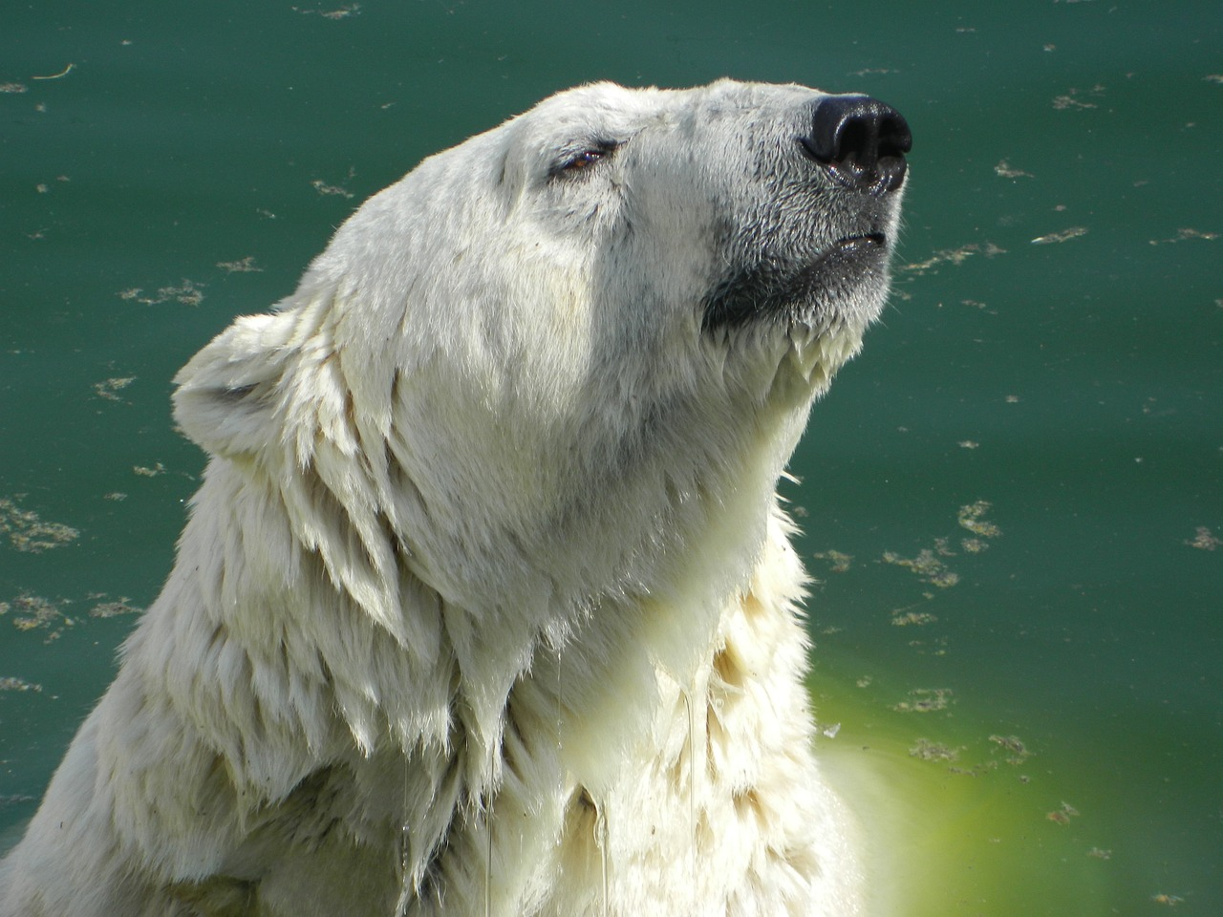
Is it a dog?
No, it isn’t.
Wow, it’s ___.
big

Slide 23
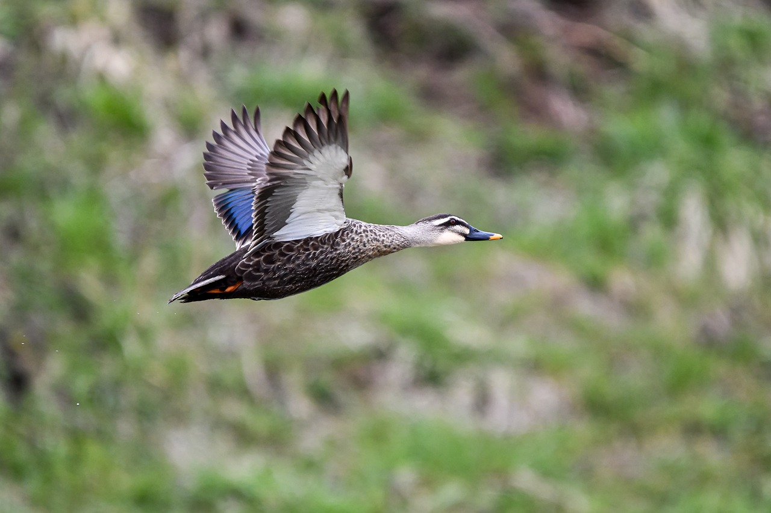
Is it a duck?
Yes, it is.
Oh, it’s ___.
fast

Slide 24
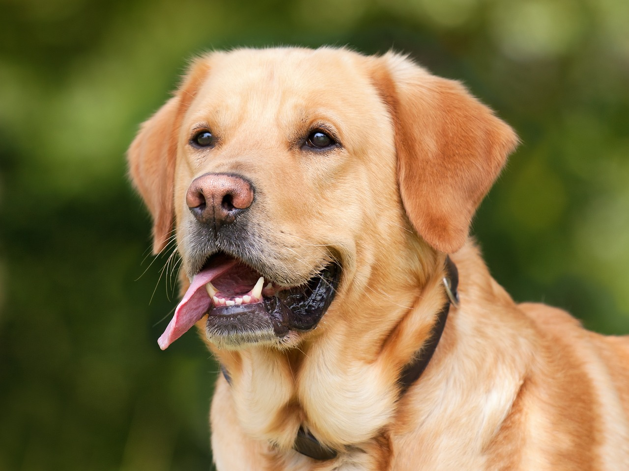
Is it a bear?
No, it isn’t.
It’s a ___.
dog

