Slide 1


Slide 2
Attributions, Usage Disclaimer & Contact
All content is either sourced from pixabay.com under the Pixabay License (royalty-free) or is original work created by the author.
This content resource is sold with usage rights granted to the purchaser only. Please do not redistribute, resell, or reupload this content in its original or modified form. Respecting these terms helps support the continued creation of these teaching materials/games!
Have a question or requests for new games or updates to existing ones? Email: korekitgames@gmail.com

Slide 3
Grade 3 – Lesson: How many cows?
This game aligns with chapters on “How many ______?” lessons and supports learning their key expressions and vocabulary. This game helps with learning numbers and counting types of animals.
Phrases and vocabulary used in this game:
How many cows / pigs / dogs / cats / ducks / rabbits?
One, two, three, four, five, six, seven, eight, nine, ten
This game serves best as a supplemental teaching resource as it includes key phrases and vocabulary from multiple commonly used English textbooks in Korea related to this lesson. This allows the resource to be applicable to most teachers while students can learn related words and phrases beyond their specific chapter, reinforcing the main lesson ideas.

Slide 4
Instructions for Game
Game Title: How many cows?
Concept: Different types of animals will pass across the screen and students should pay attention to how many of each there are. Afterwards a question will pop up asking them how many there were of one of the animal vocabulary words i.e “How many ducks?” and four number options will be provided. Students should write down the number they believe there were of the animal in question. The correct number will be the only option that is clickable (mouse arrow changes to pointer finger when hovering over correct number). Students who write the correct number should earn a point. The student(s) with the most points at the end of the game wins!

Slide 5

Instructions Continued
If you wish to mute the background music, go to the title slide/slide 6 and then click the “Animations” tab -> Animation Pane -> select the audio symbol (just above the slide) -> click the playback tab -> mute/slide the volume option down

Slide 6


How Many Cows?

Slide 7
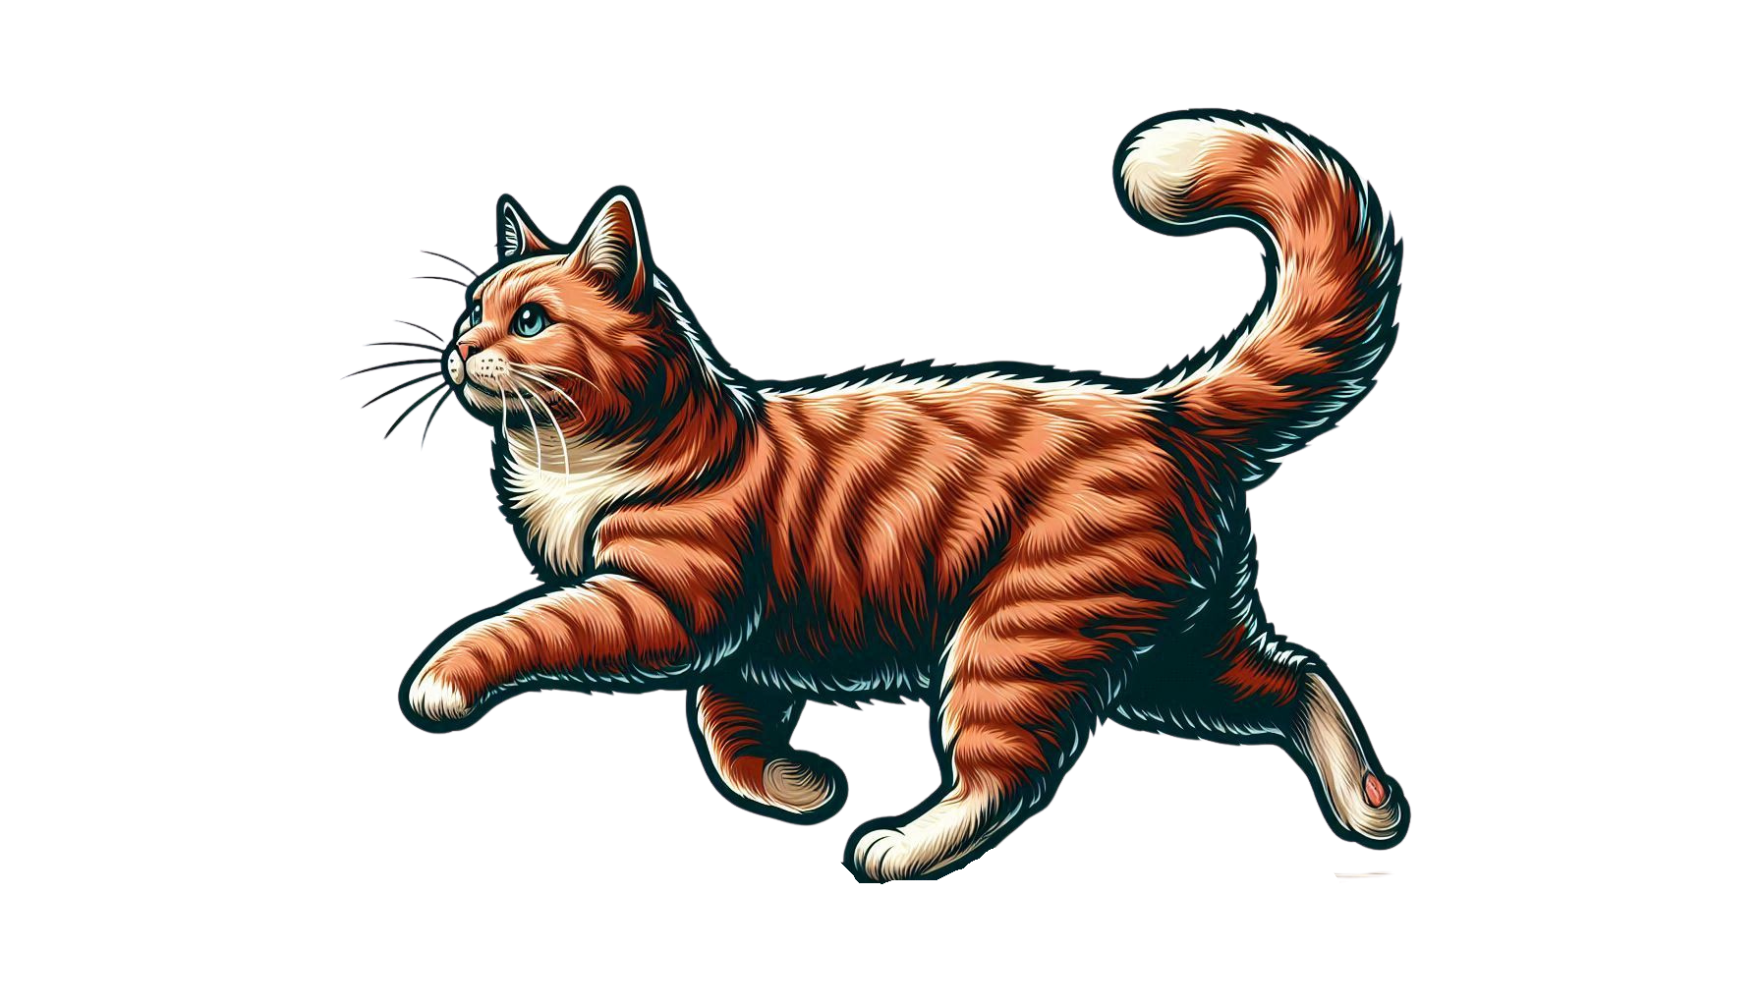
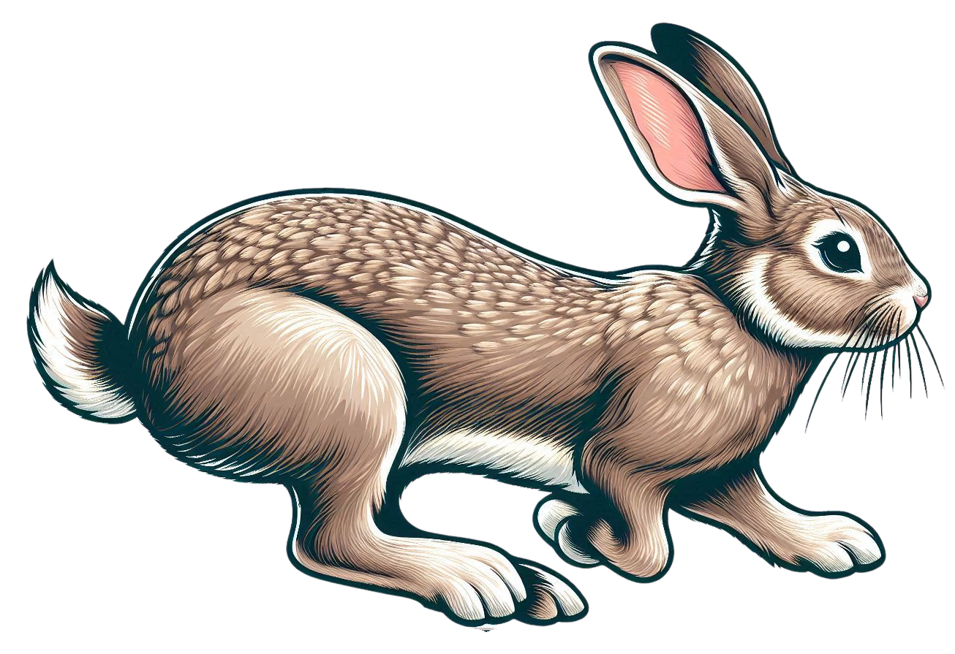
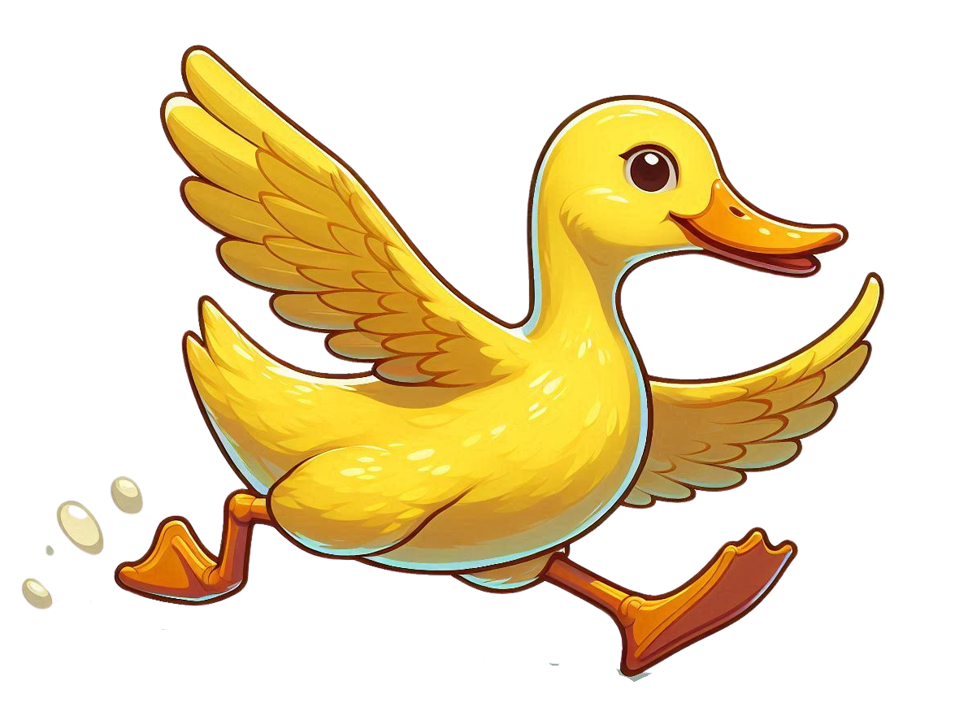
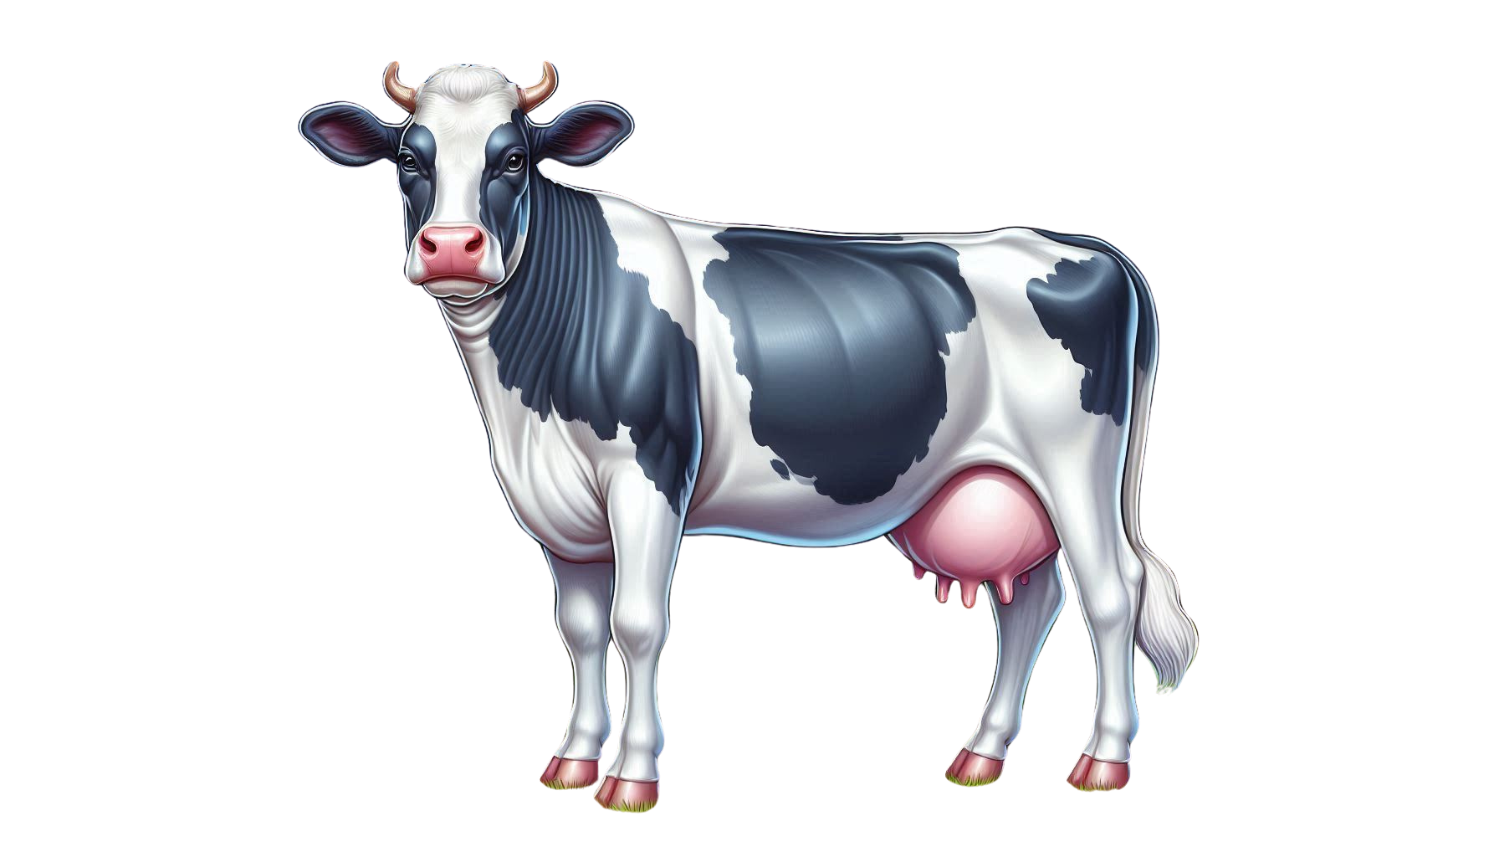

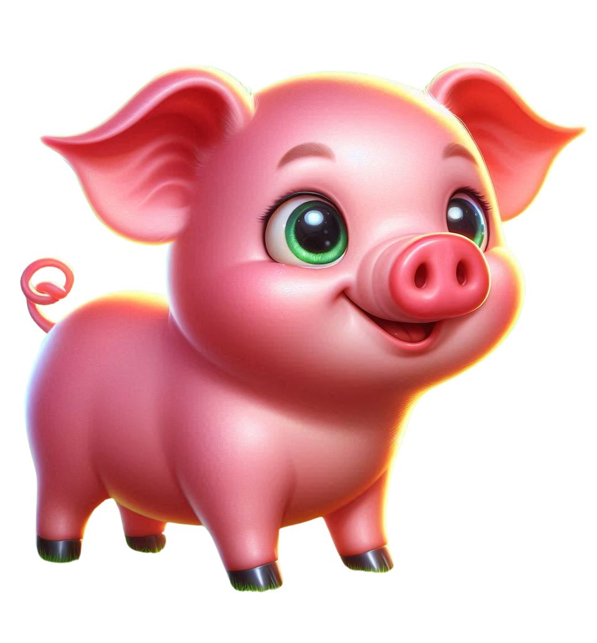
How many cows?
one
two
three
four

Slide 8
How many pigs?
one
two
three
four

Slide 9
How many dogs?
one
two
three
four

Slide 10
How many cats?
one
two
three
four

Slide 11
How many ducks?
one
two
three
four

Slide 12
How many rabbits?
one
two
three
four

Slide 13
How many cows?
one
two
three
four

Slide 14
How many pigs?
one
two
three
four

Slide 15
How many dogs?
one
two
three
four

Slide 16
How many cats?
five
six
seven
eight

Slide 17
How many ducks?
five
six
seven
eight

Slide 18
How many rabbits?
five
six
seven
eight

Slide 19
How many cows?
five
six
seven
eight

Slide 20
How many pigs?
seven
eight
nine
ten

Slide 21
How many dogs?
seven
eight
nine
ten

Slide 22
How many cats?
seven
eight
nine
ten

Slide 23
How many ducks?
seven
eight
nine
ten

Slide 24
The End!

