Slide 1

KoreKit

Slide 2
Attributions, Usage Disclaimer & Contact
All content is either sourced from pixabay.com under the Pixabay License (royalty-free) or is original work created by the author.
This content resource is sold with usage rights granted to the purchaser only. Please do not redistribute, resell, or reupload this content in its original or modified form. Respecting these terms helps support the continued creation of these teaching materials/games!
Have a question or requests for new games or updates to existing ones? Email: korekitgames@gmail.com

Slide 3
Grade 4 – Lesson: Are you happy?
This game aligns with chapters on “Are you ______?” and supports learning their key expressions and vocabulary.
Phrases and vocabulary used in this game:
Are you _______?
  Happy, sad, angry, tired, hungry, thirsty
Yes, I am. / No, I’m not. I’m _______.

Slide 4
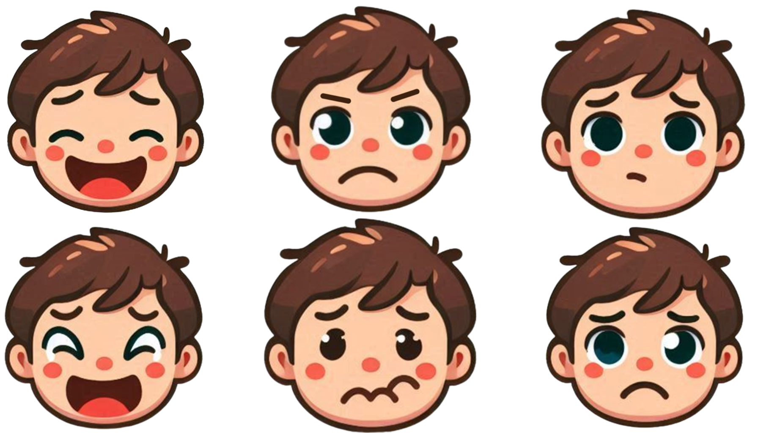
Instructions for Game
Game Title: Emotions Exposed
Concept: Show students the 6 different emotion faces to know which face is associated with which emotion on slide 5. For each slide, have students guess which emotion is being covered by writing it down and/or saying it aloud. Click to reveal the emotion of the face on the background slide – students who wrote down the correct emotion earn a point. The latter half of the game will introduce the “No, I’m not. I’m _____.” key phrase and a new emotion face will animate in to simply teach students the negative phrase. The student(s) who correctly guess the most emotions and earn the most points is the winner!

Slide 5
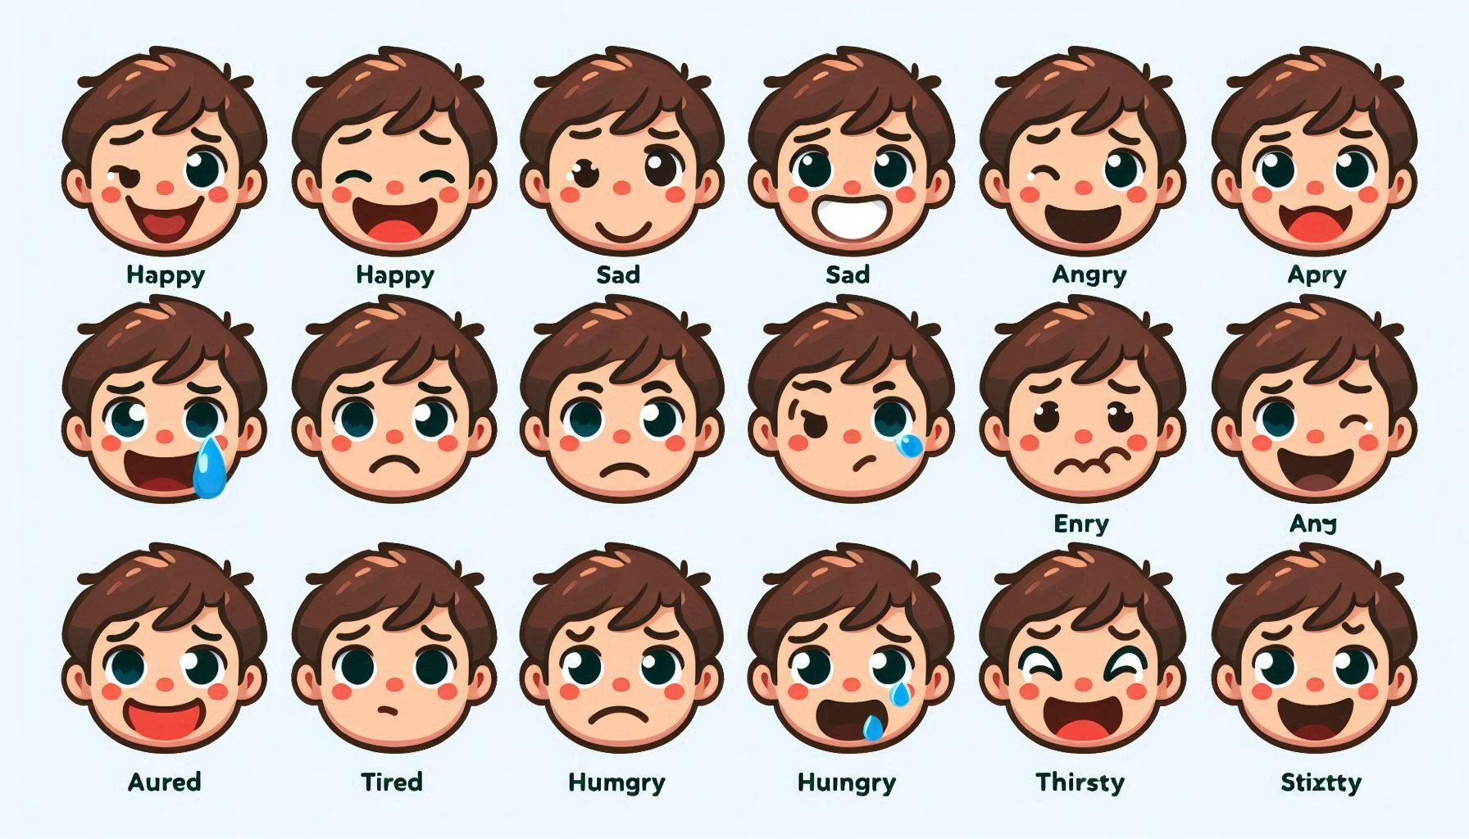
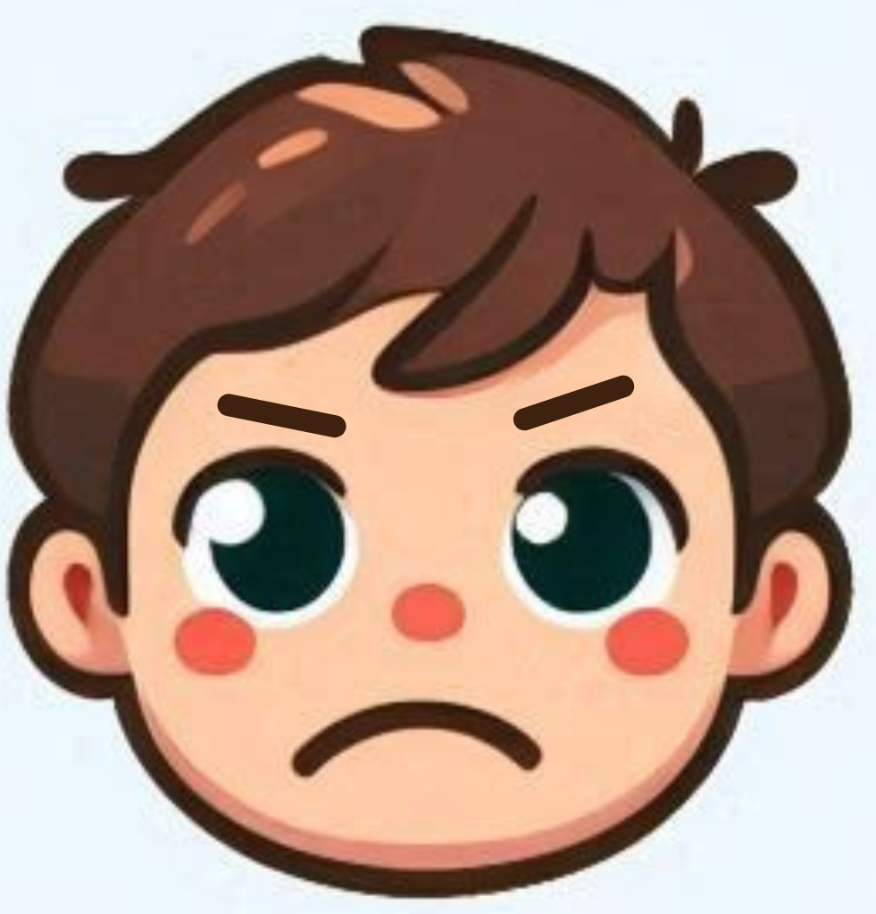
Happy
Sad
Hungry
Thirsty
Tired
Angry

Slide 6

happy
Are you _______?
Yes, I am.

Slide 7
angry
Are you _______?
Yes, I am.

Slide 8
thirsty
Are you _______?
Yes, I am.

Slide 9
sad
Are you _______?
Yes, I am.

Slide 10
hungry
Are you _______?
Yes, I am.

Slide 11
tired
Are you _______?
Yes, I am.

Slide 12
happy
Are you _______?
No, I’m not. I’m sad.

Slide 13
angry
Are you _______?
No, I’m not. I’m thirsty.

Slide 14
thirsty
Are you _______?
No, I’m not. I’m hungry.

Slide 15
sad
Are you _______?
No, I’m not. I’m tired.

Slide 16
hungry
Are you _______?
No, I’m not. I’m happy.

Slide 17
sad
Are you _______?
No, I’m not. I’m angry.

