Slide 1

KoreKit

Slide 2
Attributions, Usage Disclaimer & Contact
All content is either sourced from pixabay.com under the Pixabay License (royalty-free) or is original work created by the author.
This content resource is sold with usage rights granted to the purchaser only. Please do not redistribute, resell, or reupload this content in its original or modified form. Respecting these terms helps support the continued creation of these teaching materials/games!
Have a question or requests for new games or updates to existing ones? Email: korekitgames@gmail.com

Slide 3
Grade 4 – Lesson: How are you?
This game aligns with chapters on “How are you?” and supports learning their key expressions and vocabulary.
Phrases and vocabulary used in this game:
Hello, how are you? / I’m fine, good, great
Good morning, afternoon, evening
What is your name? / My name is ______.
Nice to meet you
This game serves best as a supplemental teaching resource as it includes key phrases and vocabulary from multiple commonly used English textbooks in Korea related to this lesson. This allows the resource to be applicable to most teachers while students can learn related words and phrases beyond their specific chapter, reinforcing the main lesson ideas.

Slide 4
Instructions for Game
Game Title: Bomb Pass
Concept: A bomb is passed around between 4 characters. Let each character represent a team. Each team should have a white board.
The bomb will continue to be passed around in a circle each time you click until it eventually explodes (after about 25 seconds from the start of each slide – you’ll hear a fuse sound shortly before the bomb exploding audio).
Have students write down and show (and/or speak) the word that appears above their character’s head once the bomb is passed to them and continue to rotate through the animation of the bomb being passed around while students write/show the word they wrote each time until the explosion audio. The animation of the bomb makes 4 complete circles and goes through 12-16 words total before ending (this should allow enough time for the bomb audio explosion to go off beforehand)
If the bomb explodes on their character/during their turn, they are out or lose a point. Click on the character who was holding the bomb during the explosion audio to send them away/trigger a flying away animation for fun.

Slide 5
Instructions for Game Continued
After sending away the character who lost, click on the blue arrow in the top left corner to get to the round 2 and round 3 options slide to pick the next round between the three remaining characters and so on. So for example, if the lion character lost in the first round, you would click on the blue box of the Mango vs. Hippo vs. Sunflower characters to begin round 2 of those three characters. The same instructions can be followed for round 3 between the final two characters and then selecting the final character who won in the blue box for a fun “Winner!” animation/celebration slide.
After finishing Game 1, escape the presentation and make your way to the beginning of Game 2 (starts slide 20) for a new set of phrases/words. Follow these same instructions and get to the next starting slide for getting through up to 5 games.

Slide 6

Editing Game
This game is editable! To do this – simply edit the text boxes to include new key words and vocabulary to replace the existing words. You may need to reposition or slightly adjust the textboxes depending on the length of the new words or phrases you enter.
If you wish to mute the background music, go to the title slide/slide 8 and then click the “Animations” tab -> Animation Pane -> select the audio symbol (just above the slide) -> click the playback tab -> mute/slide the volume option down

Slide 7






Game 1
Round 2
VS
VS
VS
VS
VS
VS
VS
VS
Round 3
VS
VS
VS
VS
VS
VS
Winner:

Slide 8
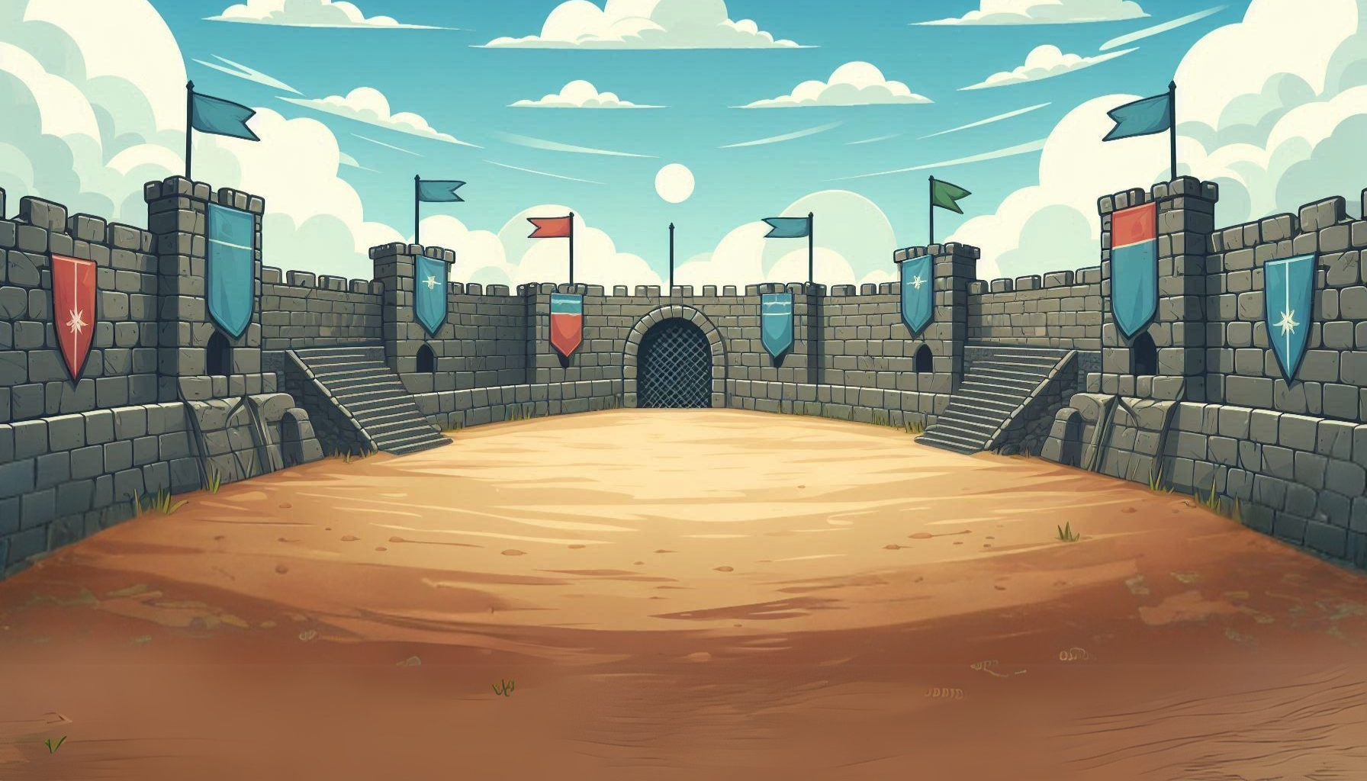



Bomb Pass
폭탄 패스

Slide 9
are
how
Hello,
you?
Hello,
you?
how
Hello,
how
are
you?
are
are
you?
how
Hello,

Slide 10
are
how
Hello,
you?
Hello,
you?
how
Hello,
how
are
you?
are

Slide 11
are
how
Hello,
you?
how
Hello,
Hello,
you?
how
are
you?
are

Slide 12
are
how
Hello,
you?
how
Hello,
Hello,
you?
how
are
you?
are

Slide 13
are
how
Hello,
you?
how
Hello,
Hello,
you?
how
are
you?
are

Slide 14
are
you?
you?
you?
Hello,
you?
how
are
Hello,
you?
how
are

Slide 15
are
you?
you?
you?
Hello,
you?
how
are
Hello,
you?
are
how

Slide 16
are
you?
you?
you?
Hello,
you?
how
are
Hello,
you?
how
are

Slide 17
are
you?
you?
you?
Hello,
you?
how
are
Hello,
you?
how
are

Slide 18
are
you?
you?
you?
Hello,
you?
how
are
Hello,
you?
are
how

Slide 19
are
you?
you?
you?
Hello,
you?
how
are
Hello,
you?
are
how

Slide 20
Game 2
Round 2
VS
VS
VS
VS
VS
VS
VS
VS
Round 3
VS
VS
VS
VS
VS
VS
Winner:

Slide 21
great
good
fine
I’m
I’m
fine
fine
great
good
great
I’m
good
fine
I’m
good
great

Slide 22
good
great
I’m
fine
I’m
fine
great
fine
good
great
good
I’m

Slide 23
fine
good
good
great
good
fine
I’m
great
fine
I’m
great
I’m

Slide 24
great
fine
good
I’m
great
I’m
good
I’m
great
fine
fine
good

Slide 25
I’m
good
great
I’m
fine
great
fine
great
fine
good
I’m
good

Slide 26
good
great
good
great
fine
I’m
I’m
fine
good
great
great
good

Slide 27
good
fine
I’m
great
great
I’m
good
fine
great
fine
fine
great

Slide 28
good
fine
good
great
great
fine
I’m
fine
I’m
good
great
good

Slide 29
I’m
fine
good
I’m
good
good
great
fine
great
great
great
good

Slide 30
fine
great
fine
great
I’m
fine
good
I’m
good
great
fine
great

Slide 31
good
great
I’m
fine
great
I’m
great
good
fine
good
fine
great

Slide 32
Game 3
Round 2
VS
VS
VS
VS
VS
VS
VS
VS
Round 3
VS
VS
VS
VS
VS
VS
Winner:

Slide 33
evening
morning
good
afternoon
good
morning
morning
evening
evening
afternoon
afternoon
good
good
morning
evening
afternoon

Slide 34
good
morning
good
evening
morning
evening
evening
afternoon
afternoon
morning
afternoon
good

Slide 35
morning
afternoon
morning
good
morning
evening
good
evening
afternoon
evening
afternoon
good

Slide 36
evening
morning
good
afternoon
afternoon
evening
afternoon
good
morning
evening
good
morning

Slide 37
afternoon
evening
morning
good
morning
evening
morning
good
evening
afternoon
afternoon
good

Slide 38
morning
afternoon
good
evening
good
evening
evening
morning
evening
morning
afternoon
good

Slide 39
morning
evening
good
morning
afternoon
good
afternoon
evening
evening
morning
afternoon
evening

Slide 40
good
morning
good
afternoon
evening
morning
morning
good
evening
afternoon
evening
afternoon

Slide 41
afternoon
good
evening
morning
evening
morning
morning
evening
evening
afternoon
good
afternoon

Slide 42
morning
afternoon
evening
good
evening
good
morning
good
good
evening
evening
afternoon

Slide 43
good
evening
good
evening
morning
morning
morning
afternoon
evening
afternoon
morning
evening

Slide 44
Game 4
Round 2
VS
VS
VS
VS
VS
VS
VS
VS
Round 3
VS
VS
VS
VS
VS
VS
Winner:

Slide 45
name?
What
is
your
What
is
What
name?
your
name?
is
your
is
your
What
name?

Slide 46
*(____) = students should spell a textbook character’s name or their own name in English
My
name
My
name
(____)
name
(____)
is
is
(____)
is
my

Slide 47
*(____) = students should spell a textbook character’s name or their own name in English
My
name
My
name
(____)
My
is
(____)
is
(____)
name
is

Slide 48
*(____) = students should spell a textbook character’s name or their own name in English
My
(____)
My
name
(____)
My
is
name
(____)
is
is
name

Slide 49
*(____) = students should spell a textbook character’s name or their own name in English
is
(____)
My
name
name
My
My
name
is
(____)
(____)
is

Slide 50
What
your
is
What
name?
your
your
name?
name?
is
name?
your

Slide 51
name?
What
your
name?
is
your
What
is
What
your
What
your

Slide 52
your
is
name?
your
name?
What
What
is
What
name?
What
name?

Slide 53
name?
What
name?
What
your
is
your
your
your
What
is
What

Slide 54
name?
What
your
name?
is
your
What
is
What
your
your
What

Slide 55
your
name?
is
name?
What
is
What
your
name?
What
name?
What

Slide 56
Game 5
Round 2
VS
VS
VS
VS
VS
VS
VS
VS
Round 3
VS
VS
VS
VS
VS
VS
Winner:

Slide 57
Nice
meet
to
you
Nice
to
meet
Nice
meet
you
you
to
to
Nice
meet
you

Slide 58
Nice
meet
meet
you
you
meet
you
to
Nice
to
Nice
to

Slide 59
Nice
meet
you
to
to
meet
you
to
meet
Nice
Nice
you

Slide 60
you
to
to
Nice
to
meet
Nice
meet
meet
you
you
Nice

Slide 61
meet
to
you
meet
to
you
Nice
you
Nice
to
meet
Nice

Slide 62
meet
Nice
Nice
meet
to
you
to
you
Nice
meet
Nice
meet

Slide 63
you
to
Nice
to
Nice
meet
meet
you
Nice
meet
Nice
meet

Slide 64
you
to
to
you
Nice
meet
Nice
meet
meet
Nice
Nice
meet

Slide 65
you
meet
Nice
meet
to
Nice
you
Nice
meet
Nice
to
meet

Slide 66
Nice
to
Nice
meet
Nice
meet
meet
you
meet
you
Nice
to

Slide 67
you
to
you
to
Nice
meet
meet
Nice
Nice
meet
Nice
meet

Slide 68

Winner!

Slide 69
Winner!

Slide 70
Winner!

Slide 71
Winner!

